Slide 1
jokes and a bit about qween latifah!
By madison runkle.

Slide 2
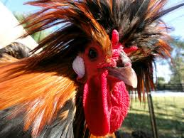
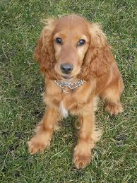
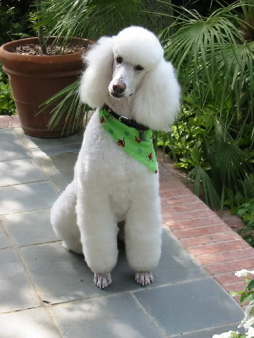
jokes and a little bit about queen latifah.
Jokes
Some jokes are about to get really funny in here so you might want to get some headphones for your relatives.
What do you get if you cross a cocker spaniel a poodle and a rooster?
a cockerpooldedo.

Slide 3
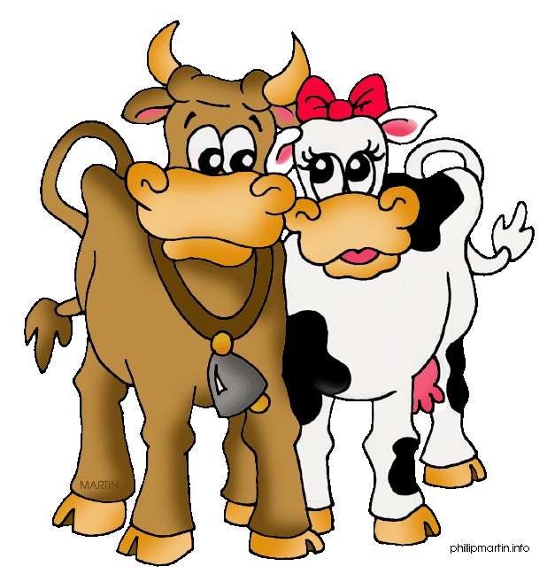
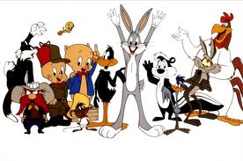
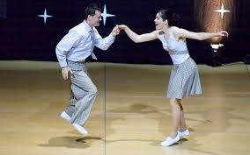
How does a farmer count a heard of cows? with a cowcalator.
What’s brown and sticky all over? A brown stick haha.
Knock knock who’s their ?What’s. What’s who? What’s up doc?
How do you make a tissue dance? You put a little boogey in it.

Slide 4
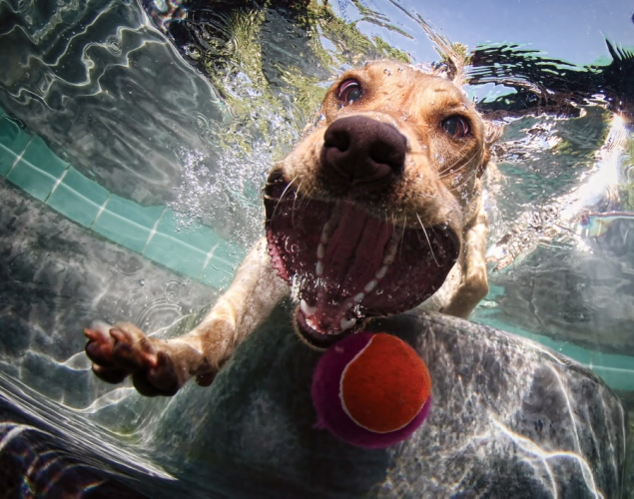
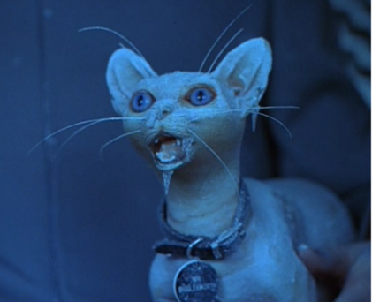
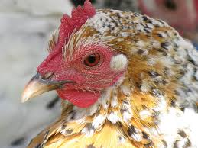
Why did the chicken cross the road?
I don’t know he never made it.
What do you call a frozen cat? A catsicle.
What is the one word a dog can say? BARK!!!
What happened to the dog when he swallowed a fire-fly ? He barked with de-light.

Slide 5
Jokes haha!!!
What did one fish say to the other fish? If you keep your’e mouth shut you won’t get caught. What’s the longest word in the dictionary the word smiles because there is a mile between each S. Who earns a living driving their customers? A taxi driver. What is black and white,white and black,
black and white? A zebra in a revolving door. Why did the cook get arrested? Because he beat up an egg. What did the pig say when the man grabbed him by the tail? That’s the end of me. What has eyes and is lying on the ground? The Mississippi River. What’s white black and red all over a penguin with a diaper rash.

Slide 6
Okay now I’m going to tell you a little bit about Queen Latifah. Queen Latifah is a famous rapper singer actor and she tells a lot of jokes. Okay let’s start talking about her. All right first of all her real name is Dana Elaine Owens. She was born March 18,1970. She now is forty-two. She was born in Newark New Jersey. She is five foot ten. Well that is all .Thanks for reading.

