Slide 1
A BAD TIME IN HISTORY
BY SOPHIE BERKELEY

Slide 2
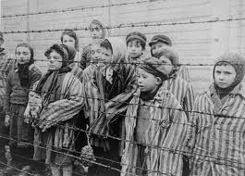
THE HOLOCAUST

Slide 3
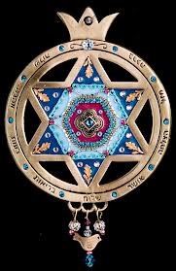
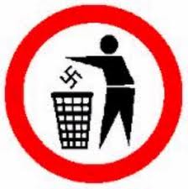
9 FACT YOU NEED TO KNOW ABOUT THE HOLOCAUST
THE NAZIS KILLED 6 MILLION JEWISH PEPOLE.
THE HOLOCAUST WENT FROM JANUARY 1933 TO MAY 8 1945.
THEY KILLED OVER ONE MILLION CHILDREN.
THEY KILLED 2 MILLION WOMEN AND 3 MILLION MEN.
THE JEWISH PEPOLE WERE ALL VERY SKINY.
THEY WOULD TRANSPORT THEM IN CATTLE CARS.
AND THE CATTLE CARS DID NOT HAVE FOOD, WATER, OR A TOILET.
THEY EVEN SLEPT ON LITTLE SHELVES.
THE HOLOCUAST LASTED 12 YEARS.

Slide 4
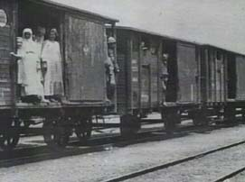
HOW THE JEWISH PEOPLE TRAVELD
This is a picture of one the cattle cars the Jewish people traveled in. The longest trip they ever took during the war was 18 days long, and remember the Jewish people did not have food, water, or a toilet. Well any way when the soldiers opened the door all the people inside it were dead.

Slide 5
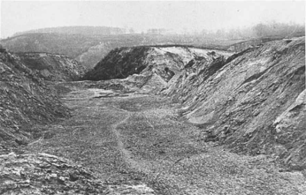
THE MOST INTENS KILLING
THE MOST INTENSE KILLING TOOK PLACE ON SEPTEMBER 1941, AT THE BABI YAR REVINE JUST OUT SIDE OF KIEVUK, RAIVNE. MORE THAN 33,000 JEWS WERE KILLED IN JUST 2 DAYS. THEY WERE FORCED TO WALK TO THE REVINE EDGE. WHEN THE GERMAN TROOPS SHOT THEM THEY FELL INTO THE RAVINE. THE NAZIS THEN PUSHED THE WALL OF THE RAVINE OVER, BURYING THE DEAD AND THE LIVING. POLICE WOULD GRAB CHILDREN AND THROW THEM INTO THE RAVINE AND KNOCK DOWN THE WALL OF DIRT ON TOP OF THEM.

Slide 6
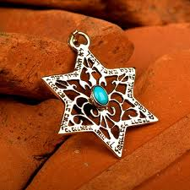
THE HISTORY OF THE STAR OF DAVID
The legend goes that when David was a teenage boy he was in a battle with king Nimrod . On the inside of his circular shield he had 2 triangles. As the battle raged the two triangles started to forge together and became the Magen David or the star of David.

Slide 7
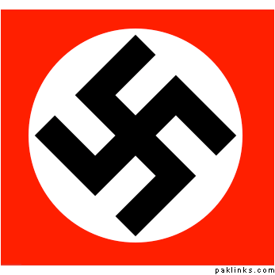
THE SWASTIKA
The swastika was an ancient Indian symbol. Hitler was obsessed with ancient religions and was convinced that the Germans were the descendants of the Aryan race which was actually Asian. He was so sure that he sent scientist's to Asia to measure the people`s features to confirm that they were the same as Germans. Since the swastika was from that region he incorporated it in to the Nazi flag.

Slide 8
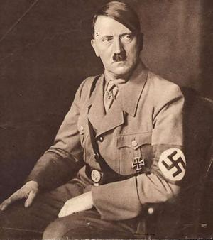
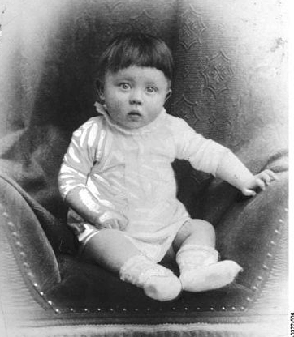
Adolf Hitler
Adolf Hitler was very attached to his mother.
He did not like his father. And when ever he
came to their house he would scream and yell.
to

Slide 9
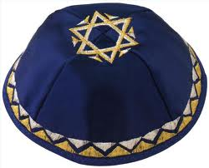
The Jewish hat

Slide 10
THE END
THANK YOU FOR READING A BAD TIME IN HISTORY!!!!!!!!!!!!!!!!!!!!!!!!!!!!!!!!!!!!!!!!!

