Slide 1
dogs
By Anna Logan

Slide 2
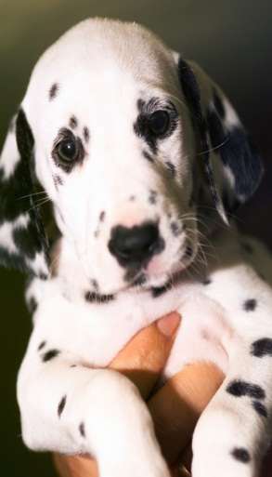
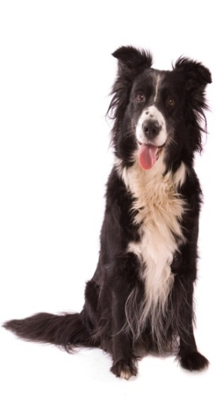
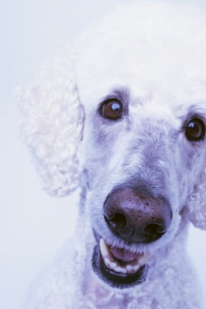
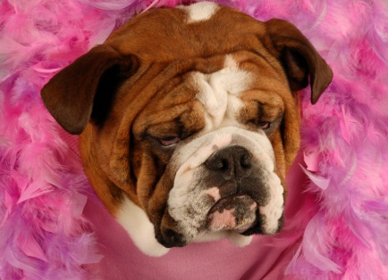
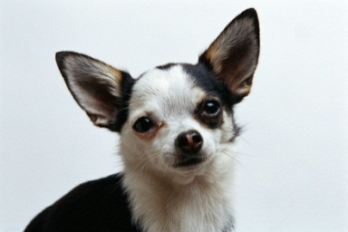
Dog breeds
Here are some dog breeds; a bulldog , a collie , dalmatians, poodles, an American Eskimo Dog, Boston Terrier , and a Chihuahua.(pictures below)

Slide 3
Breeds and facts
Bull Dogs are very energetic.
Chihuahuas are very little.
Poodles can sometimes be shaved and look very pretty.
Dalmatian's love to run.
Collies are very gentle and very long haired.
American Eskimo Dogs are like a big ball of cotton or fuzz.
Boston Terriers are small dogs too.

Slide 4
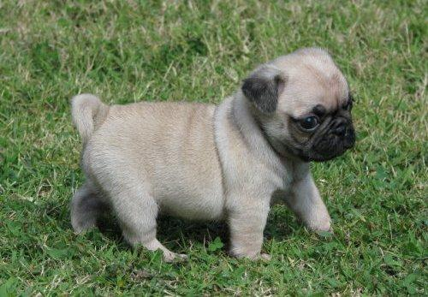
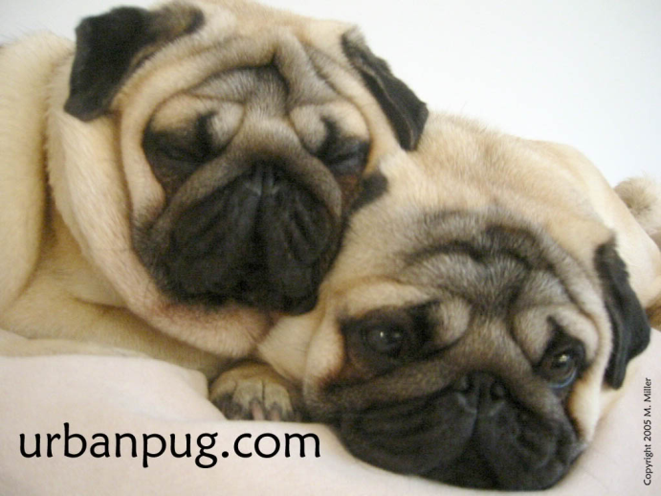
pugs
Pugs are kind of small , full of energy , very playful , nice to strangers, and they are even a good watch dog too!

Slide 5
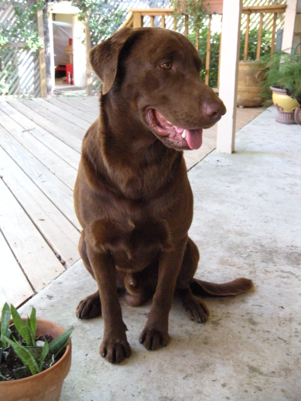
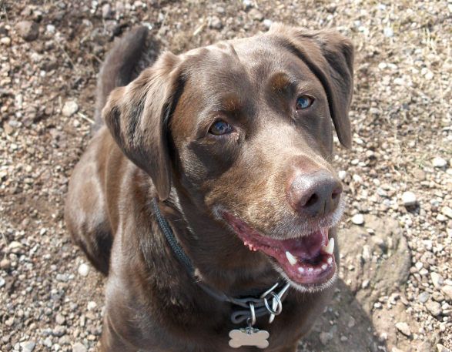
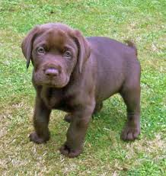
CHocOLATE lABS
Chocolate Labs are very energetic and very playful. Their tails are always pointed and they can weigh up to 120lbs! They became a dog breed in 1917.

Slide 6
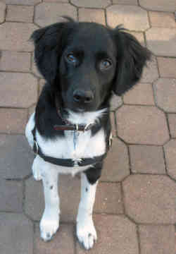
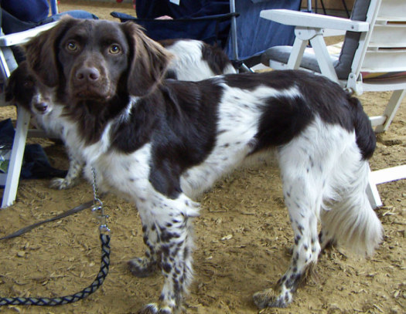
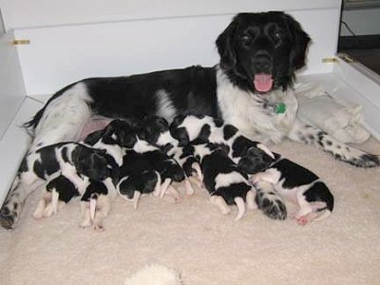
Rare dog breed
Have you ever heard of a dog breed called a Stabyhoun? Well right now there are 3,507 left in existence. They are very playful , have a lot of energy, very gentle, and are a great companion.

Slide 7
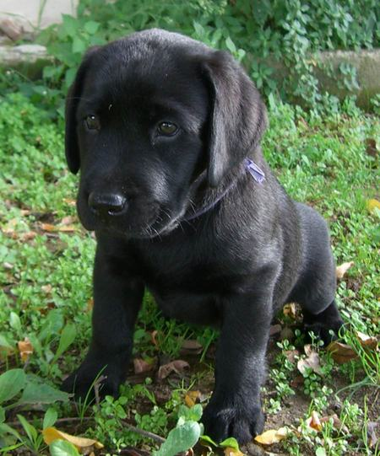
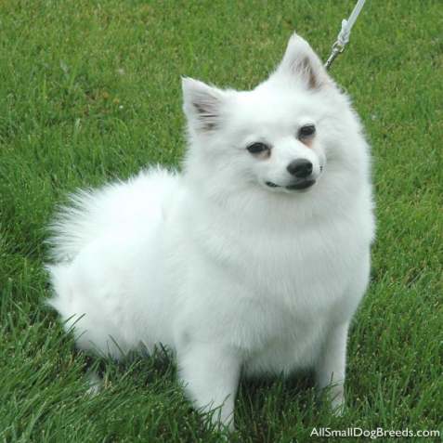
Dogs compared
Dogs are the same in many different ways.
they might act the same or they might look the same
there are many different kinds of dog food .
dogs come in different colors

Slide 8
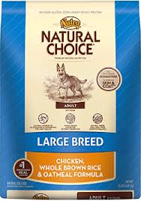
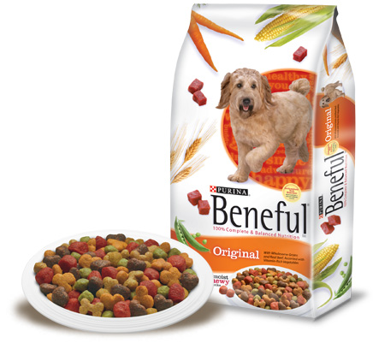
Dog food
There are many different kinds of dog food . Each dog needs a different kind of food or it could get very sick . Here are some different kinds.

Slide 9
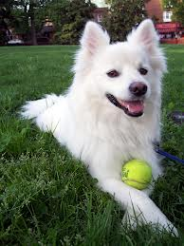
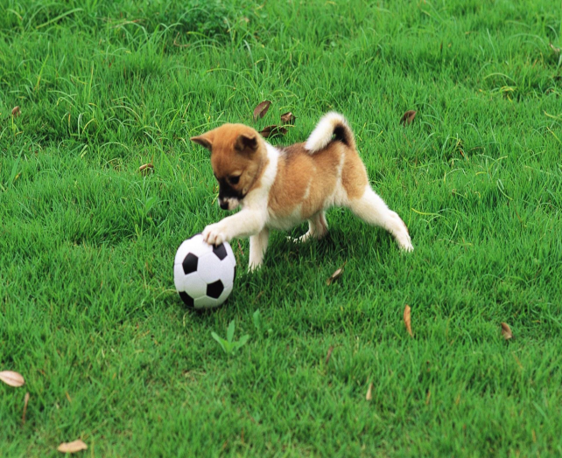
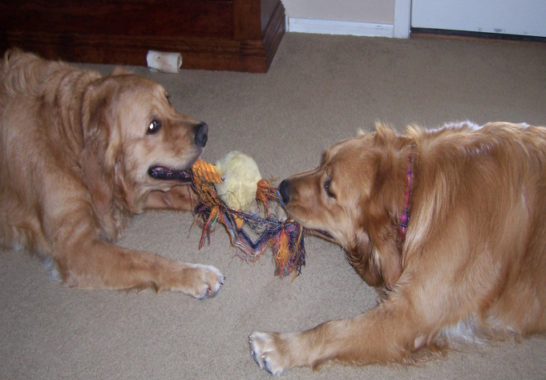
toys
Most of all dogs love to play. And that’s why they like toys .

Slide 10
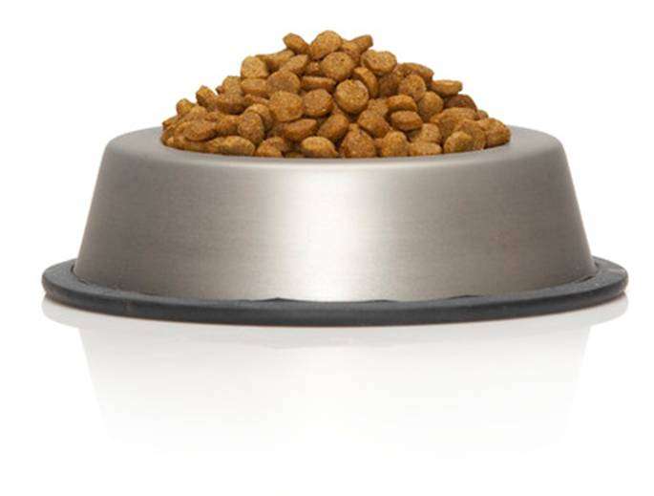
THE END
Thanks for watching DOGS BY Anna. Hope to see you soon!!!

