Slide 1
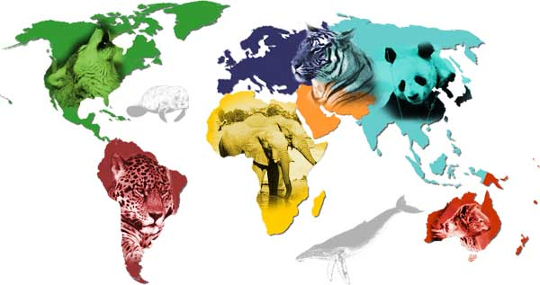
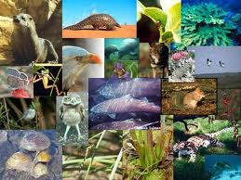
Endangered Animals By: Denisa Refatllari

Slide 2
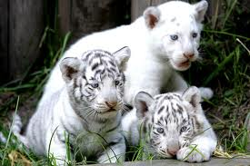
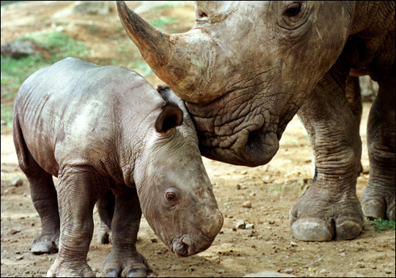
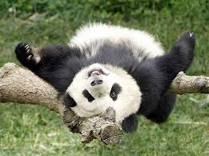
Endangered Animals
There are lots of endangered animals out there. Some endangered animals are at risk of being extinct. There are plants, animals, and insects that are endangered. There are hundreds of endangered animals out there.

Slide 3
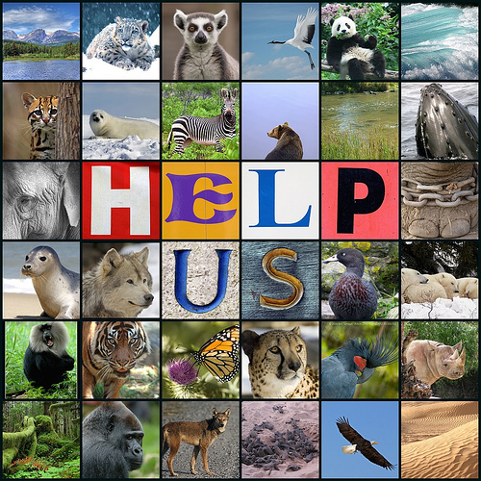
Endangered Animals
Top ten endangered animals are ;
Ivory billed wood pecker
Amur tiger
Javan rhinoceros
Northern sportive lemur
Northern right whale
Western low land gorilla
Leather back sea turtle
Siberian (Amur ) tiger
Chinese salamander
Little dodo bird

Slide 4
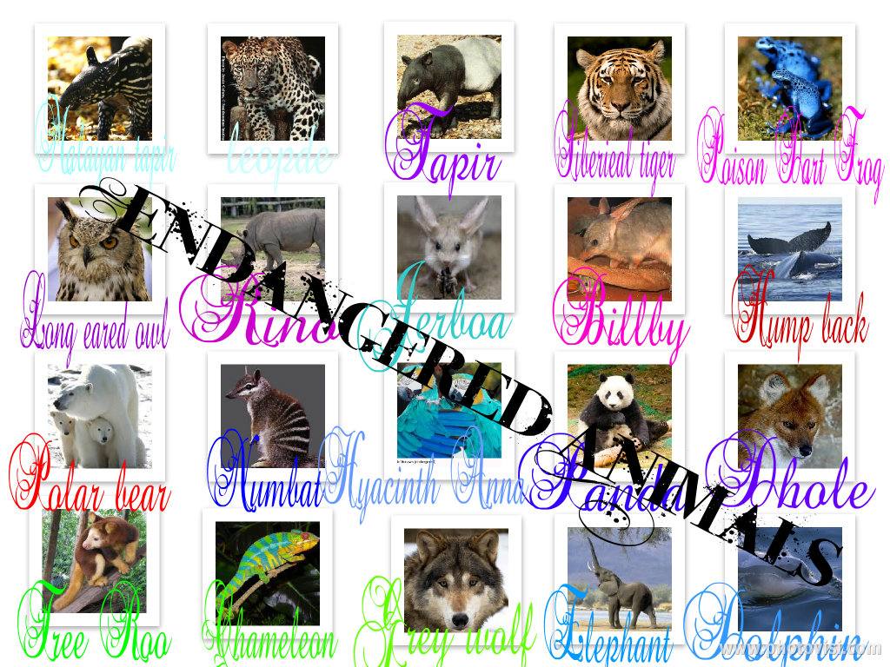
Endangered Animals
Over 1,000 endangered animals at the varied levels across the world.
In 2006 6,524 vertebrate animals were listed as threatened
The number of endangered animals listed 935.

Slide 5
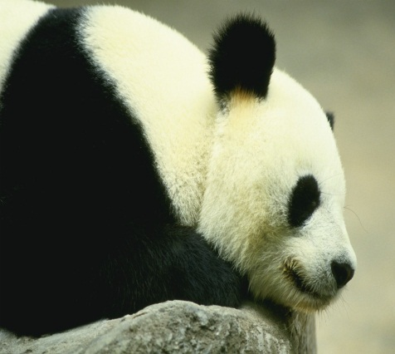
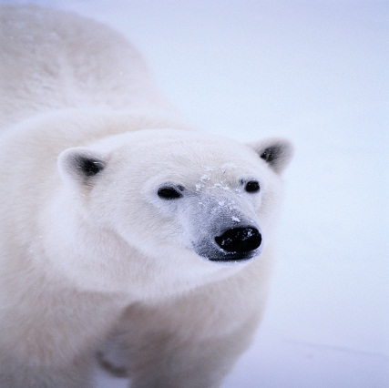
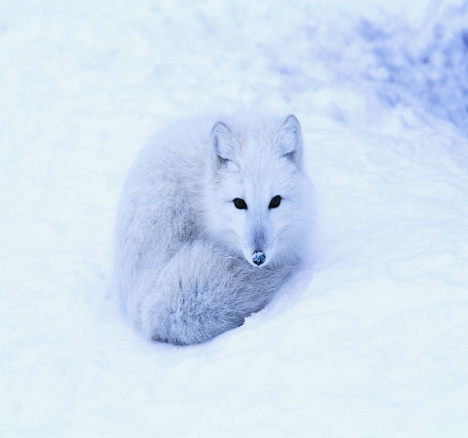
Endangered Animals
Some countries that have endangered animals ;
India
China
United States
Mexico

Slide 6
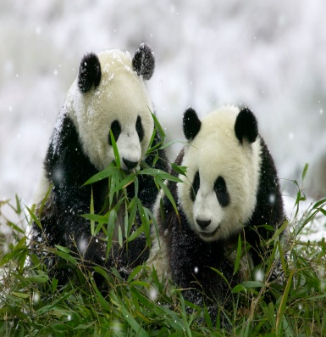
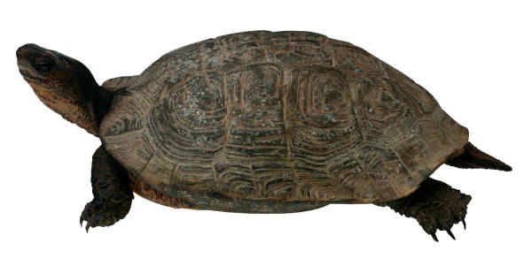
Endangered Animals
To protect endangered animals.
Not hunting those animals.
Being careful not destroying their homes
Try not to air polluting their homes.

Slide 7
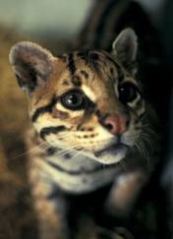
Endangered Animals
The saddest fact is that humans’ activities are bringing an ever-increasing decline in animals that are endangered.
Numerous species have gone into extinction and belong to museums around the world.
Endangered animals are slowly moving to being extinct all around the world.

Slide 8
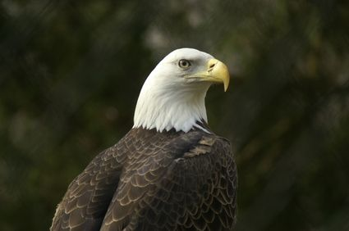
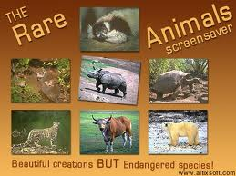
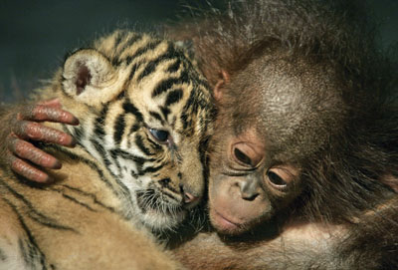
Endangered Animals
There are animal activists around the world who are making every attempt they have to protect those endangered animals.

