Slide 1

Flowers with Brittney
By: Brittney

Slide 2
Some interesting facts
Some fun facts
Flowers are associated with the different purposes and symbolism and is used for different purposes.
There are over 2,500,000 species of flowers in the world
Plants survive winter by going dormant, its like how bears hibernate.
Some plants survive with underground storage organs such as potatoes , tap roots such as carrots, and bulbs such as onions

Slide 3
The Rose
Meaning of a rose
It is a symbol of love and passion. Greeks and romans associated it with the goddess of love. The rose was used for hundreds of years to convey messages without words.

Slide 4
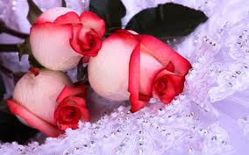
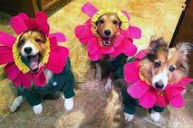
Different types of flowers
Some different types of flowers are Austin, Alba, Bourbon, Buck, Grand Flora, Miniature, Climber, Tree Roses, and Tulips

Slide 5
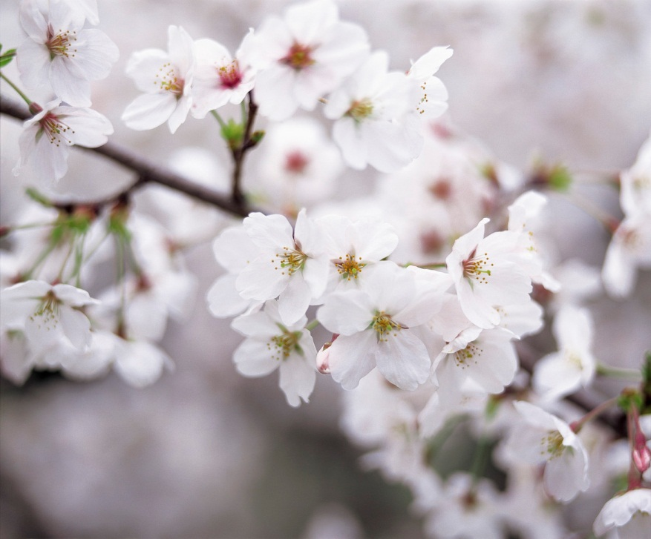

The different facts between a dandelion and a cherry blossom
The Cherry Blossom
Some facts about cherry
blossoms!
In 1912 the people of Japan sent 3,020 cherry trees to the United States as a gift of friendship.
The dandelion
The dandelion flower open to say hi to the morning and closes to go to sleep.

Slide 6
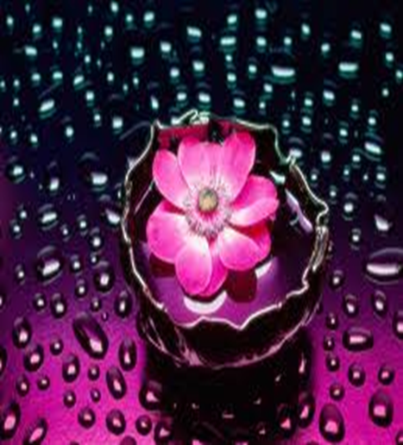
Flower jokes
What does one call a country where people only drive pink cars… a pink carnation
Why did the butterfly get a cellphone….. Because he wanted to cauliflower
What did the doctor say to her patient when she gave her a shot? I hope thistle make you feel better!

Slide 7
The math of a flower
A flower that can get very tall is a sun flower
How long does a flower grow for? It needs to grow for five days to sprout but it usually takes a month.

Slide 8
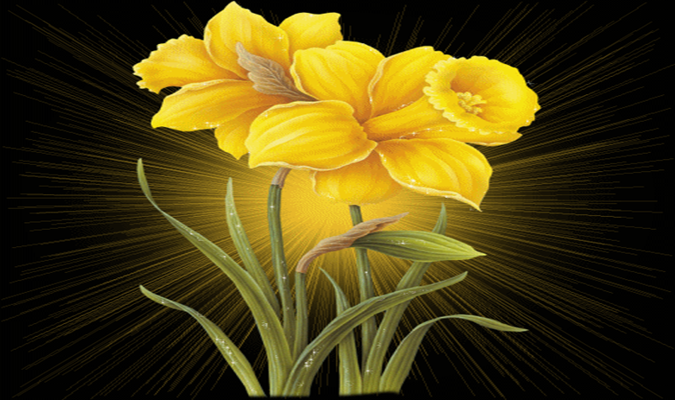
This has been flowers with Brittney see you soon!!!!!!!

