Slide 1
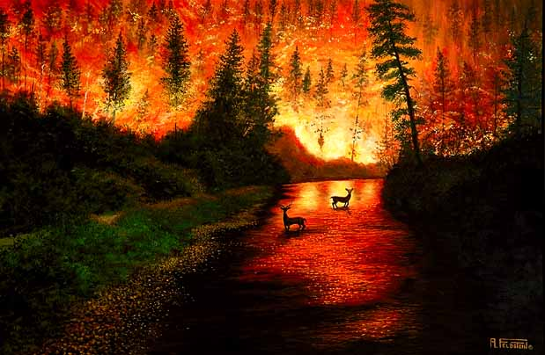
Forest Fires
By: Bryce, Ireland, Anjilica ☺

Slide 2
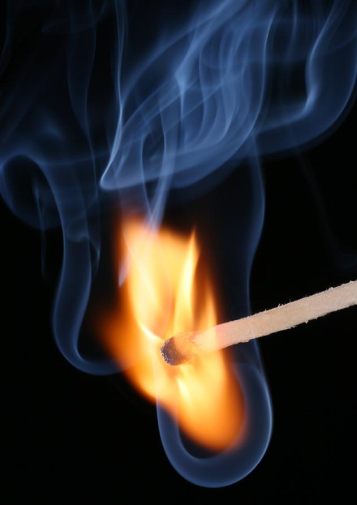
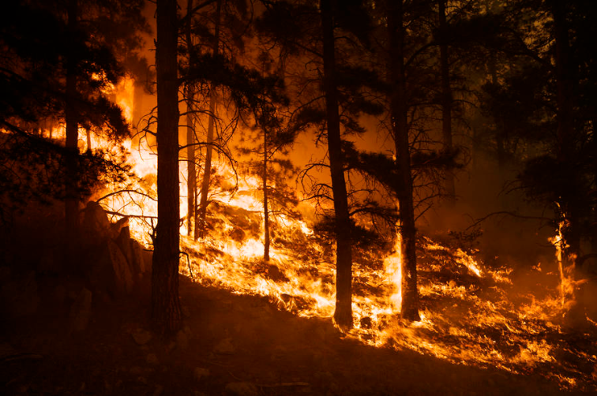
How do forest fires occur?
A forest fire can occur by…
Lightning
Camp fires that are not put out
And matches

Slide 3
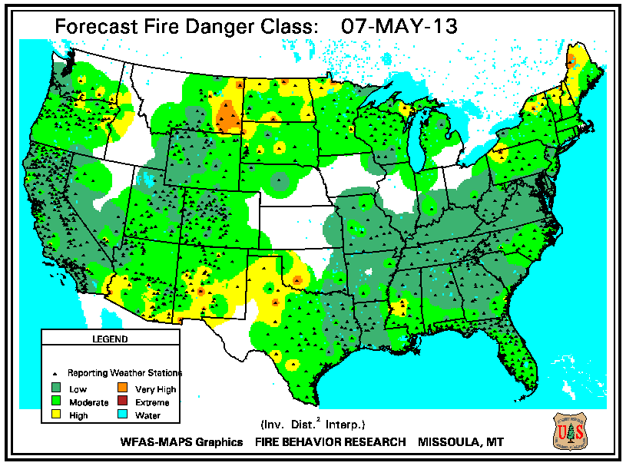
Where does it form?
Where there is a lot of forests like Wyoming, Utah, and Colorado.

Slide 4
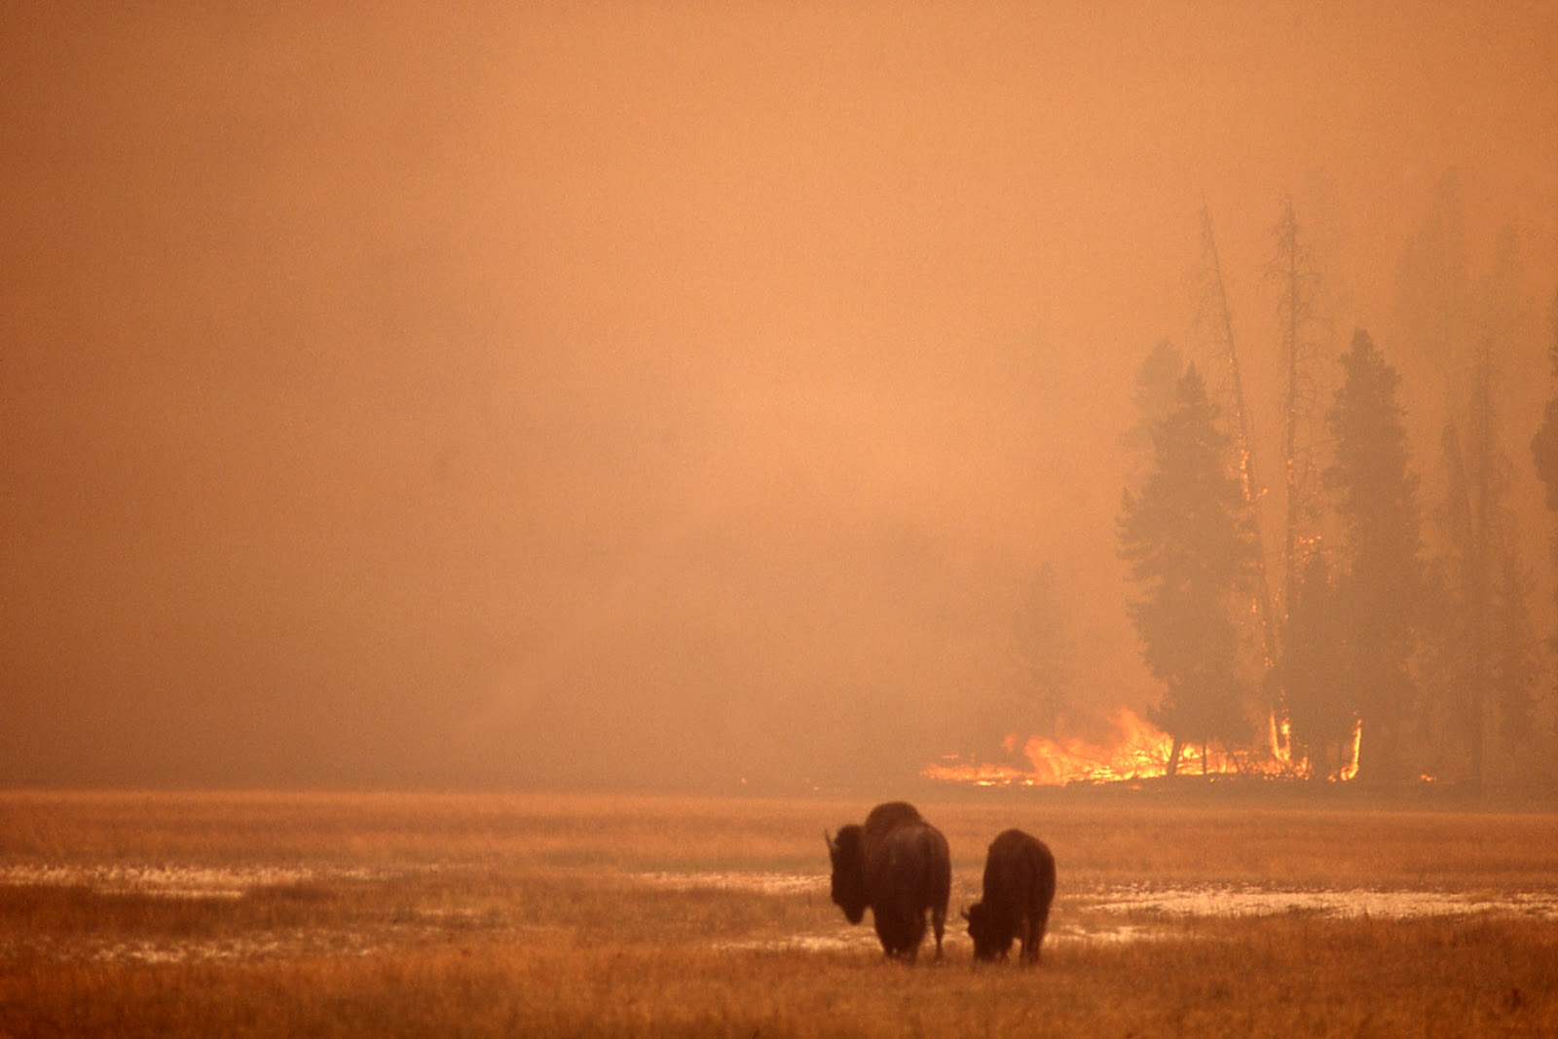
How is it dangerous?
It kills wildlife and anchors of forest

Slide 5
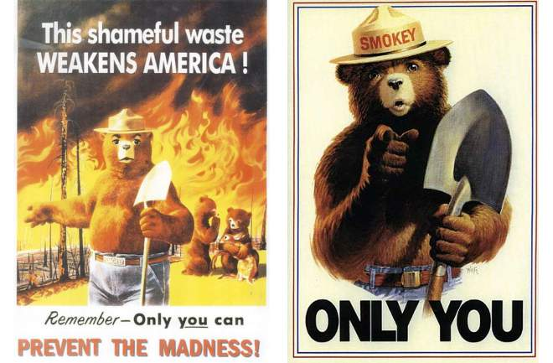
How did the forest fire get it’s name?
It got it’s name because it is a fire that takes place in a forest.

Slide 6
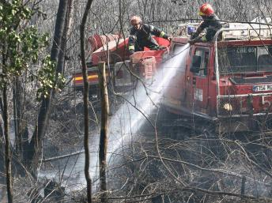
How can the forest fire be prevented?
The forest fire can be prevented by people not using matches and throwing them on the ground when done using, put out campfires when done using, and if you see a small fire started that needs to be put out grab water and dump it on the small fire. But if it’s big call the fire department and they will handle it.

Slide 7
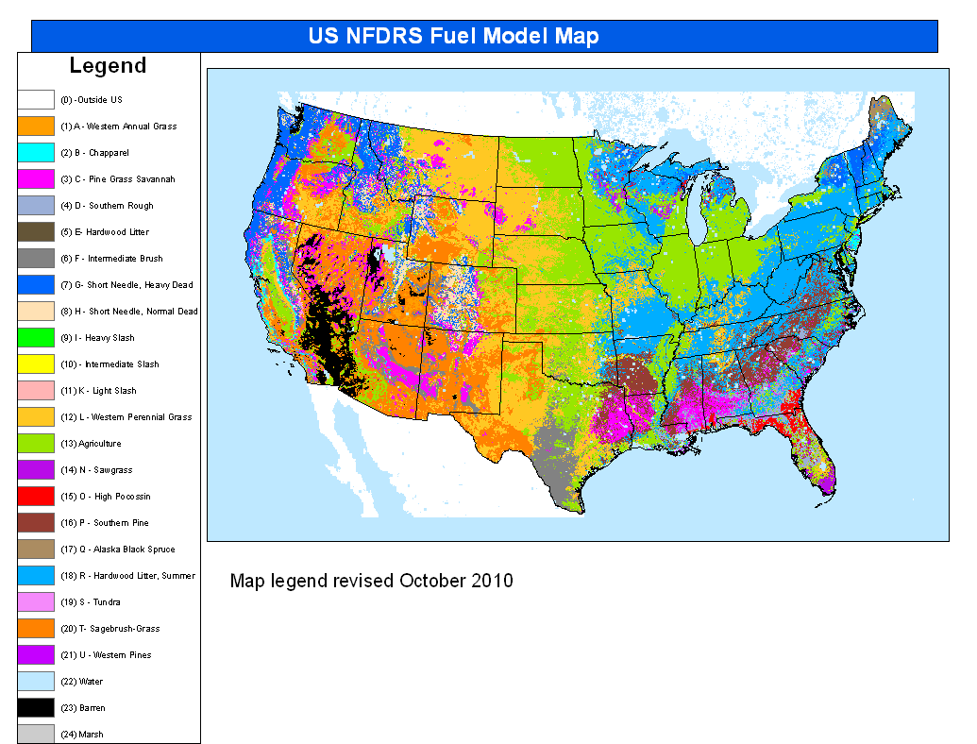
Can it be predicted?
It can be predicted by the temperature outside and the alerts for storms will get sent out on phones and TV’s so they will know that there will be lightning which can cause a forest fire.

Slide 8
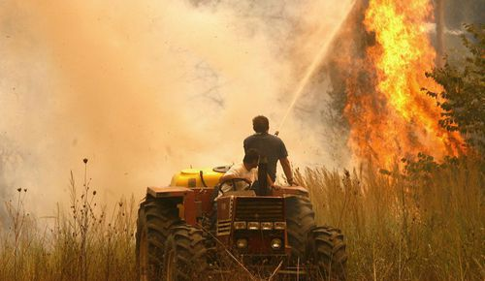
How would you react to it?
If there was a forest fire by your house what would you do?
You should make sure you have smoke detectors in your house, you should always have a plan like climbing out you window and having a meeting place.

Slide 9
What is a natural resource?
It is something that is supplied by nature.
Some examples are diamonds, fish, fruits, and zinc.

Slide 10
What is a nonrenewable resource?
A nonrenewable resource is something that will eventually run out. Some examples are oil and gold.

Slide 11
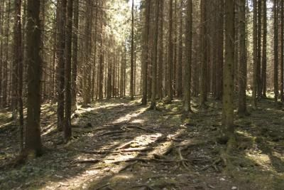
What is a renewable resource?
A natural resource is something that will never run out. An example is grass and tree’s.

Slide 12
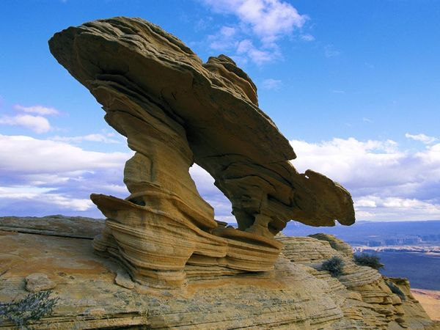
What is erosion?
Erosion is the process of eroding or being eroded by wind or other natural agents. Example is sand blasting into a rock.

Slide 13
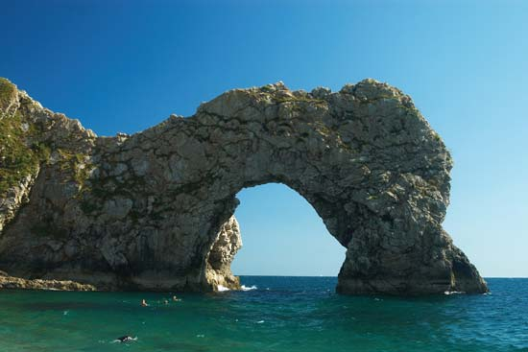
What is weathering?
Weathering is the breaking down of substances such as rocks and minerals by physical change. An example of weathering is rocks being made smooth by tumbling across a streambed.

Slide 14
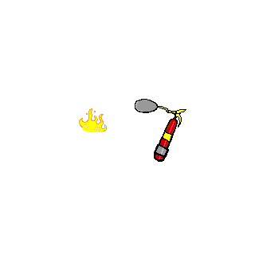
5 facts about forest fires
More than 80 percent of wildfires are started by human.
An average 1.2 million U.S woodland burn every year.
Lighting strikes the earth over 100,000 times a day. 10 to 20 percent of these lighting strikes can cause a fire.
In recent years wildfires have burned up to 9,000,000 anchors of forest.
4 out of every 5 wildfires are started by humans.

Slide 15
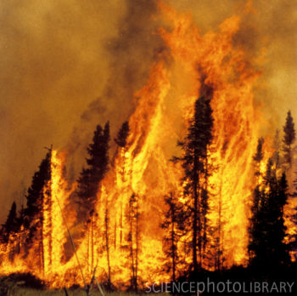
Thanks for watching

Slide 16
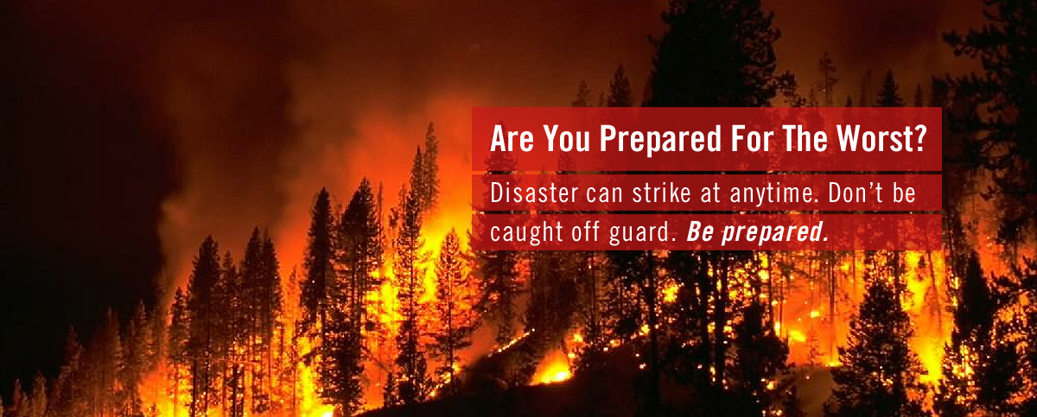
How many forest fires happen every year?
Every year 106,260 forest fires happen. So many forest fires happen every year because during camping season people will start a fire and forget to put it out. Also kids and alcoholics play with matches and throw them on the ground.

