Slide 1
Natural resources
A natural resource is a material that comes from the earths surface.

Slide 2
erosion
An example of erosion is wind ,water and wood is erosion.

Slide 3
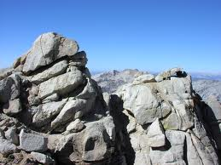
weathering
Weathering is the decomposition of earths rocks soils and there minerals.

Slide 4
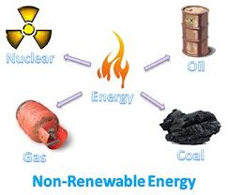
Nonrenewable resource
Oil ,nuclear ,gas and coal makes energy that is nonrenewable.

Slide 5
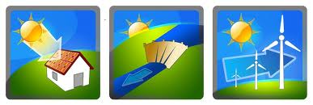
RENEWABLE RESOURCE
A renewable resource is something that can be used twice like wood wind and water.

Slide 6
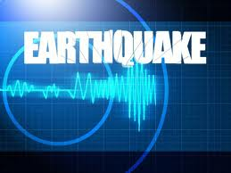
EARTH QUAKe video
http://www.youtube.com/watch?feature=player_detailpage&v=7kuejrI3OhQ

Slide 7
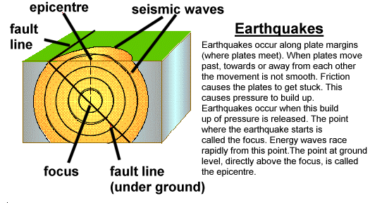
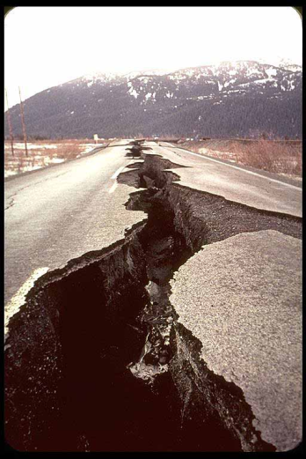
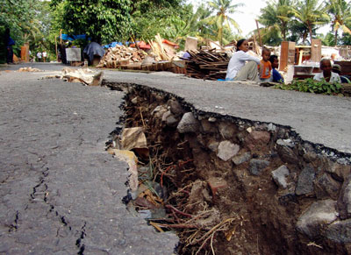
How does it occur and what causes it
Earthquakes are caused when rock underground suddenly breaks along the surface of the earth.

Slide 8
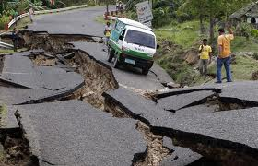
How earthquakes get their name
They got their name because scientists choose random letters from the alphabet.
Here’s a picture of a earthquake.

Slide 9
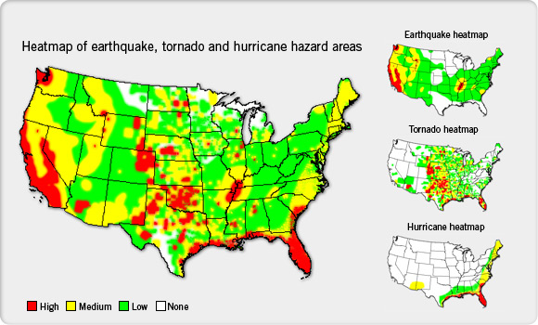
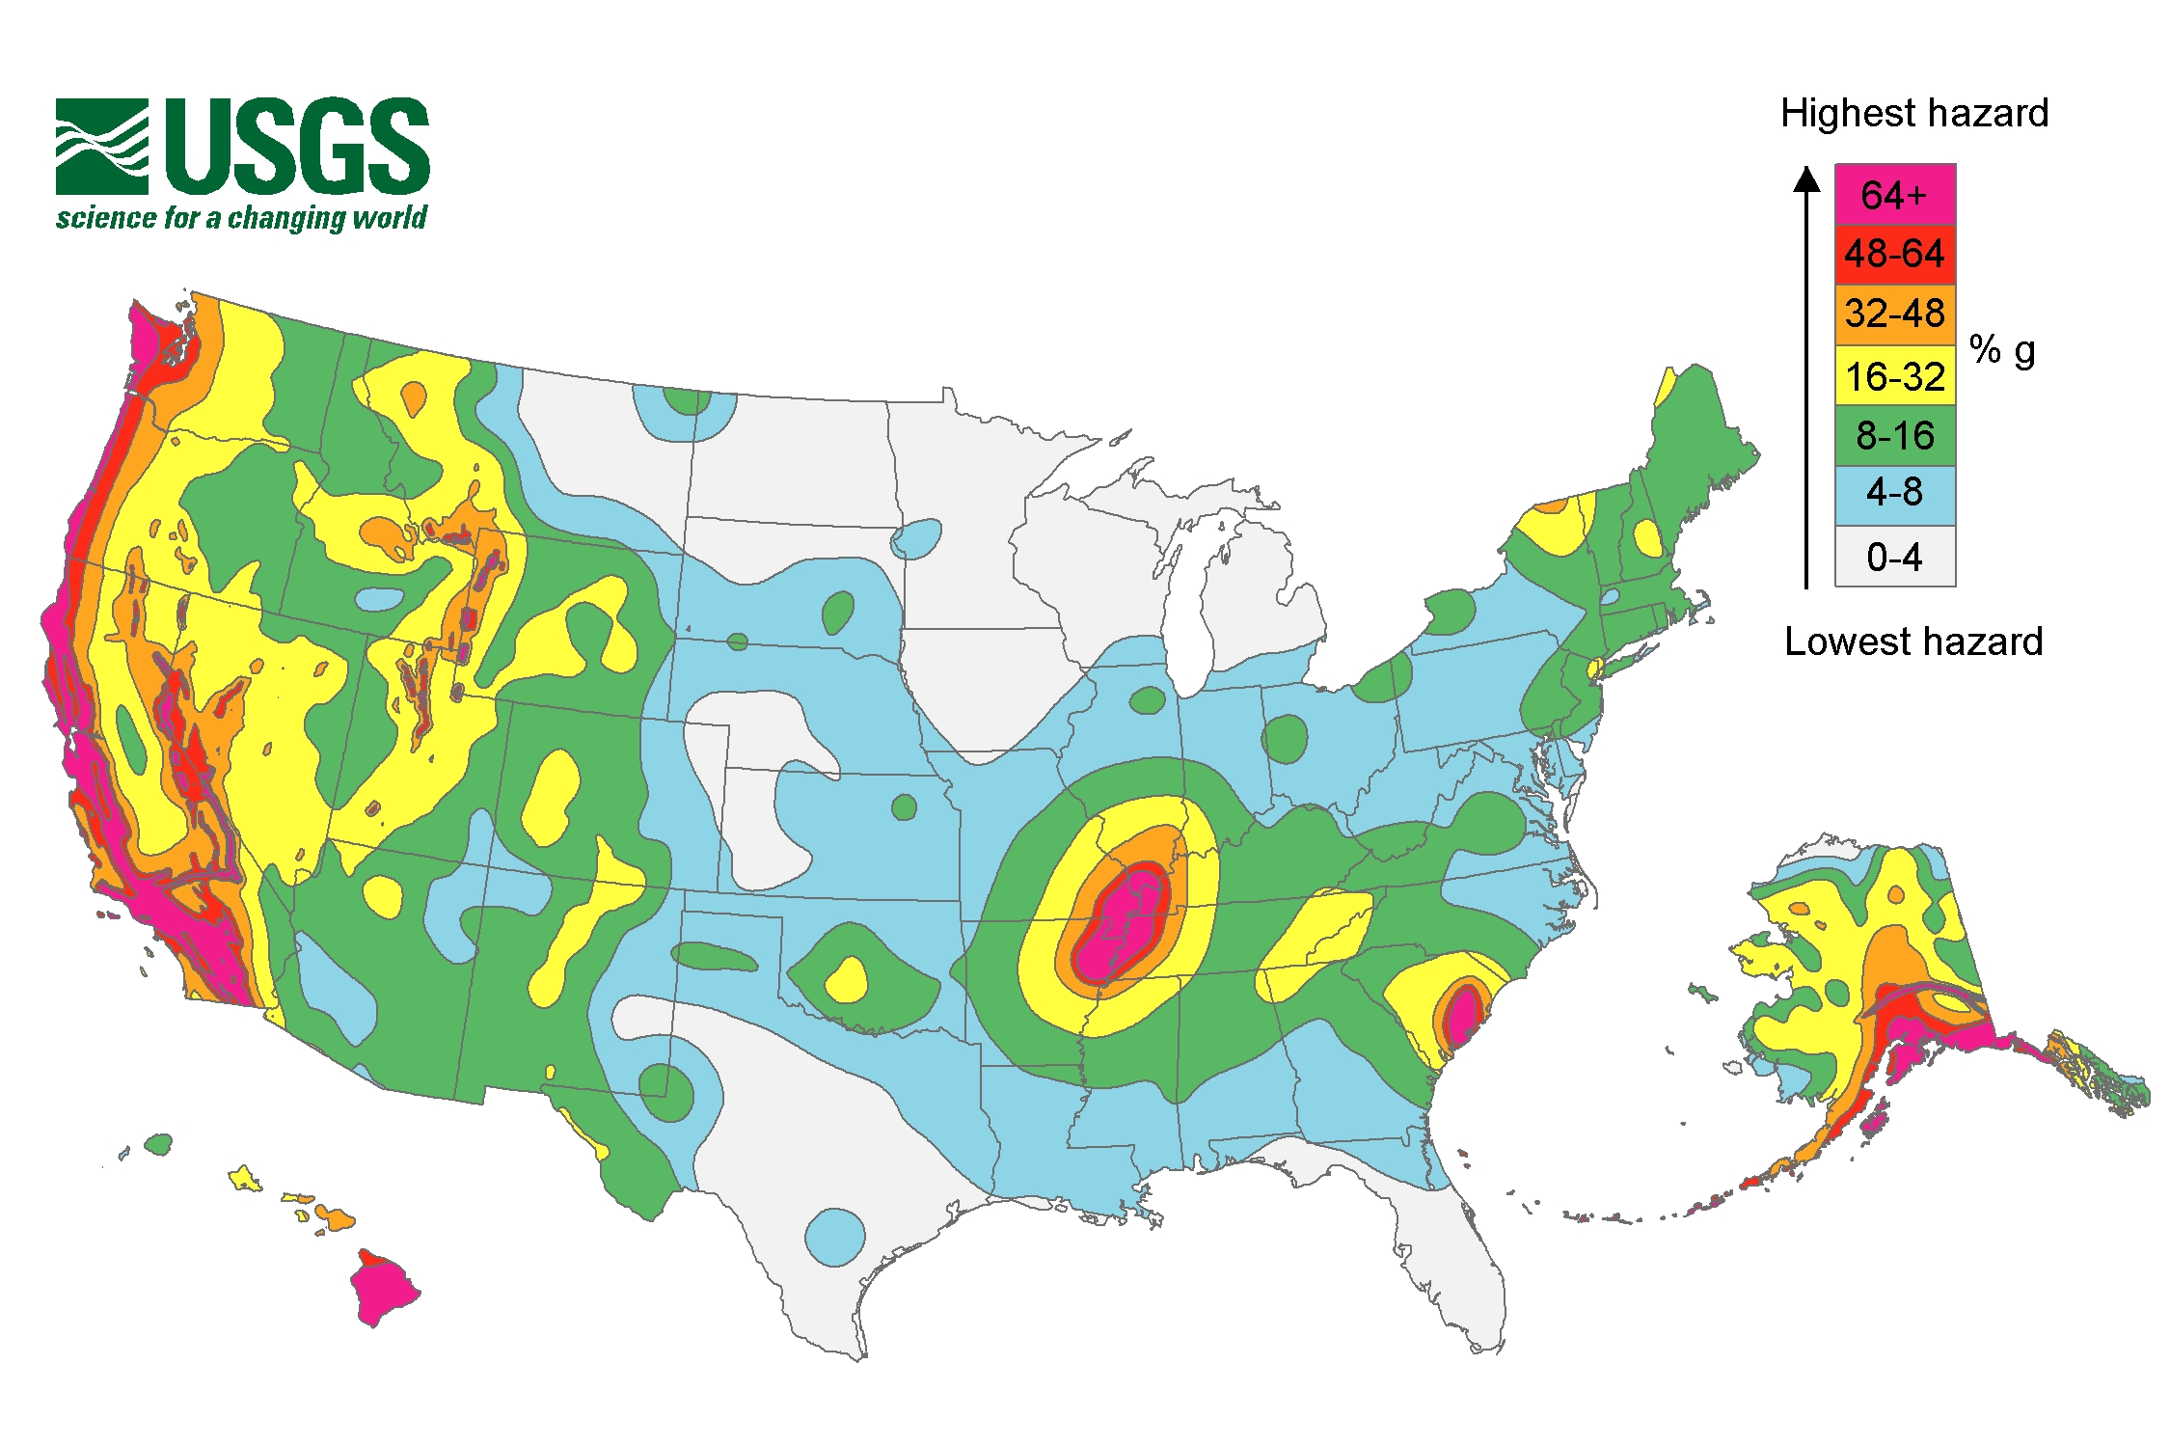
Where does it form most
They form along the oceanic and continental plate.

Slide 10
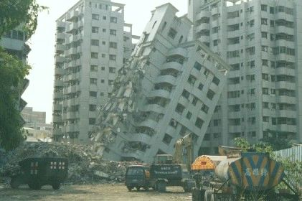
CAN EARTHQUAKES BE PREVENTED
THEY CANT BE PREVENTED .THE BEST THING WE CAN DO IS BE READY WHEN IT COMES

Slide 11
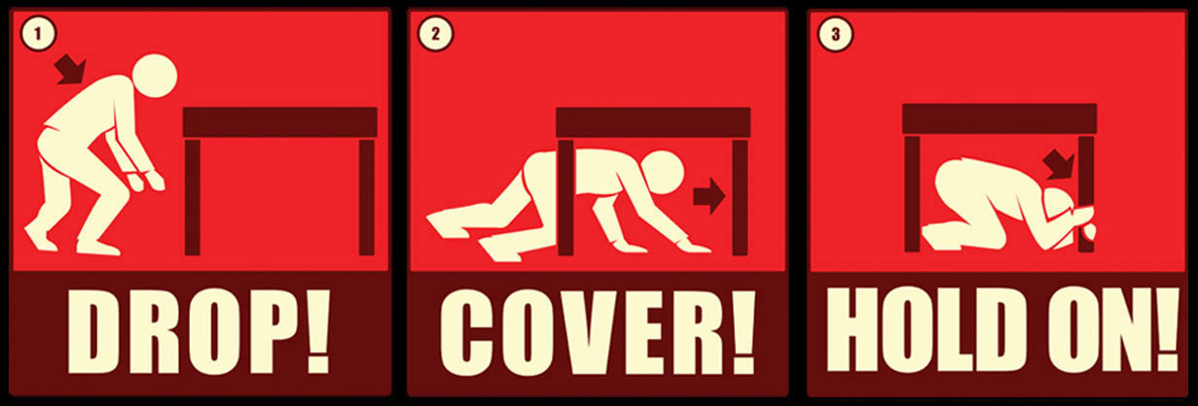
HOW DO WE REACT AT SCHOOL
How
WE REACT YOU DROP DOWN ON THE FLOOR COVER YOUR NECK AND HOLD ON TO SOMETHING

Slide 12
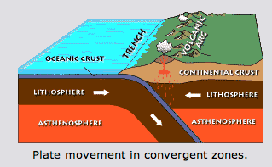
Diagram of earthquake
Heres a diagram of A EARTHQUAKE

Slide 13
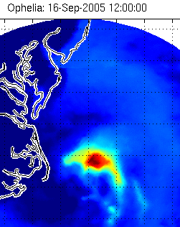
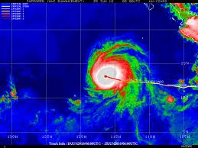
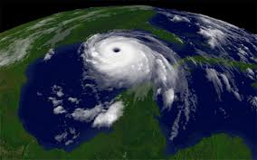
HERE ARE DIFFERENT TYPES OF EARTHQUAKE
An earthquake can be big or small.

Slide 14
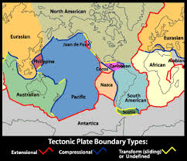
Earthquake facts
1. THEIR DANGEROIS
2. CAN KILL up to 200 people
3. HUGE

Slide 15
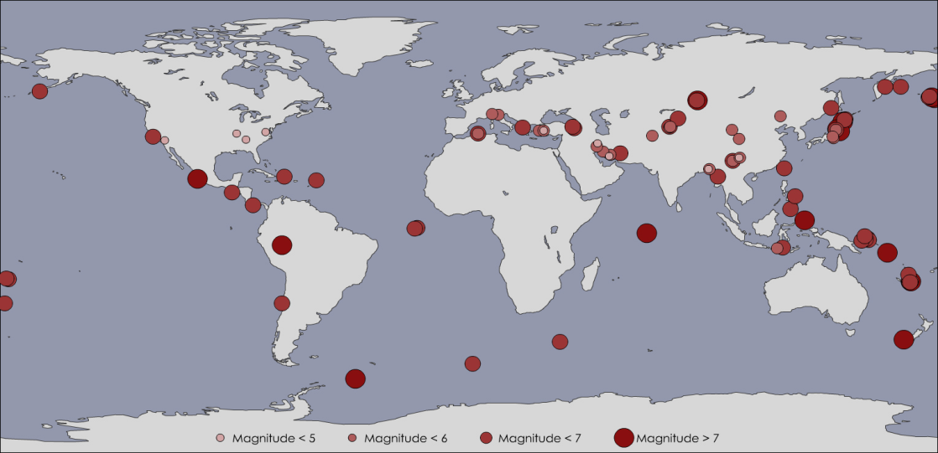
A MAP OF EARTHQUAKE
AN EARTHQUAKE CAN STRIKE IN THESE ARIES

Slide 16
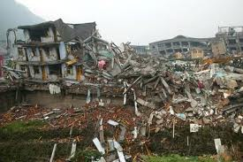
How earthquake got its name
Scientist don’t know how earthquakes got their name so the answer is we don’t know.

Slide 17
the end!!!!!!!
Made by EMILY MATT AND ELYSIA

