Slide 1
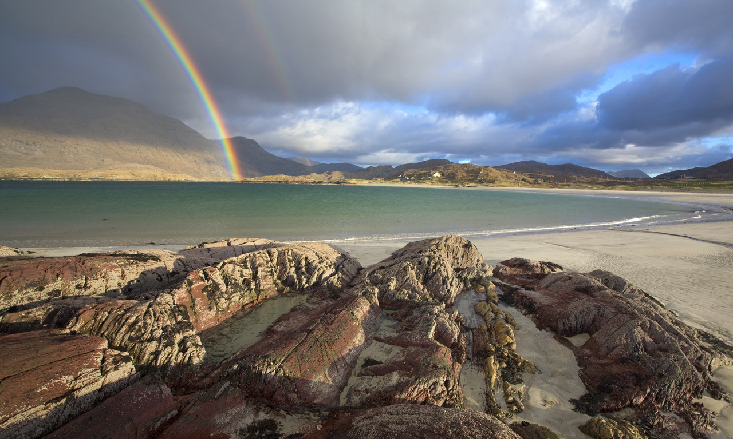
Ireland!
by: Ireland Bradfield

Slide 2
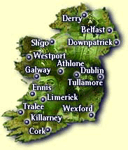
Do you want to learn about different countries?
Well, I’m writing about Ireland just for you!!

Slide 3
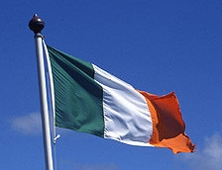
The Irish flag
Did you know that the Irish flag was made in the 1800’s? The person who made it was Thomas Francis Meagher. He was born on August 3RD, 1823. He died on July 1st, 1867.
The colors of the flag are green, white, and orange in that exact order as you can see in the picture on the right.

Slide 4
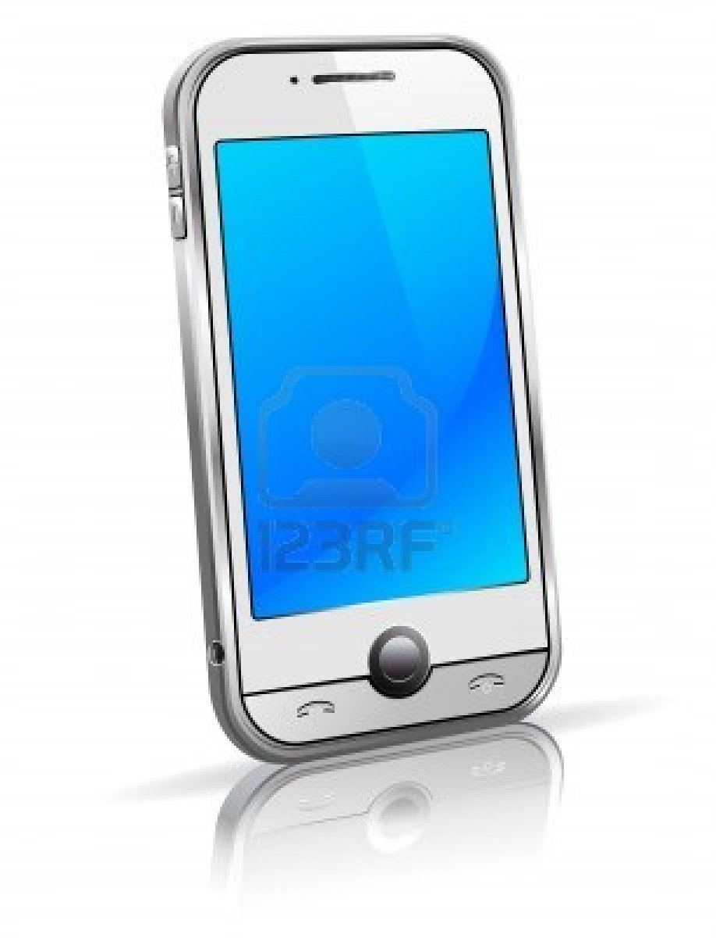
Mobile Phones
Now, if you like mobile phones like me you’ll be glad to know that there are more mobile phones than people in Ireland. I was surprised when I heard that.

Slide 5
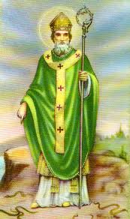
St.Patricks Day
Time to talk about a holiday. You know how we celebrate all those holidays like Valentines Day and Christmas? Well, one is honoring an Irish man named St.Patrick. He was not born in Ireland but later on he became part of the Irish heritage, mostly through his services across Ireland in the 5th century. On Saint Patrick’s Day people wear green and dye their hair green to avoid getting pinched. In Ireland the girls will wear green bows in their hair. You normally think of green on Saint Patrick’s right? But the original color of Saint Patrick’s Day is blue. The picture below is of St. Patrick.

Slide 6
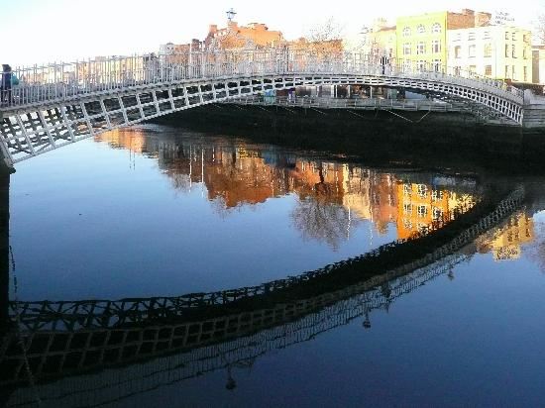
The capital of Ireland and a popular place.
Now, I’m going to tell you about the capital of Ireland. It’s Dublin. Dublin is the most populated state in Ireland.
A place you should visit If you go to Ireland is Dublin City.

Slide 7
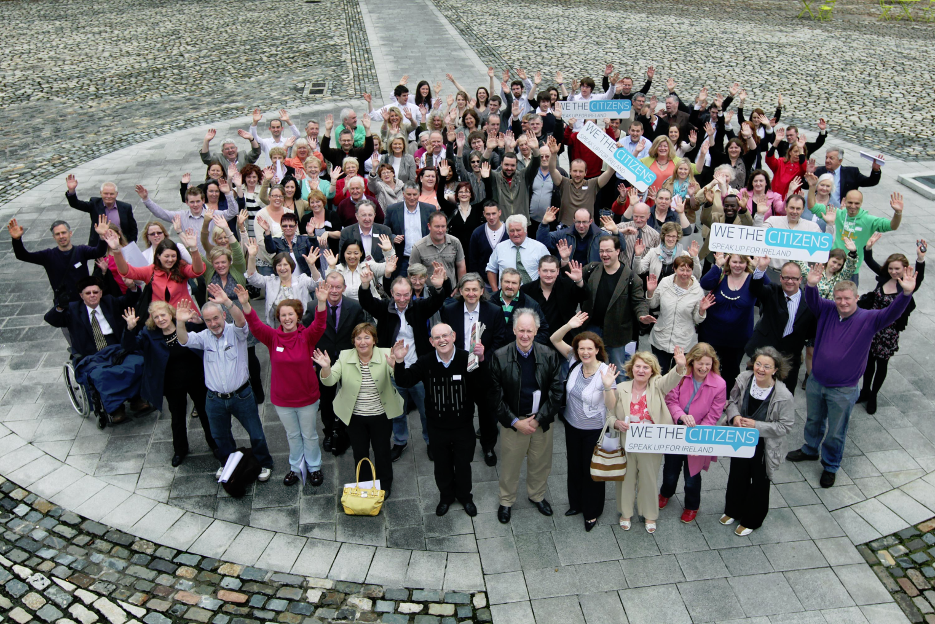
The population
The population of Ireland is about1,775,000.

Slide 8
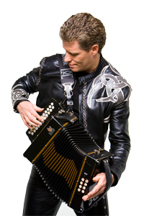
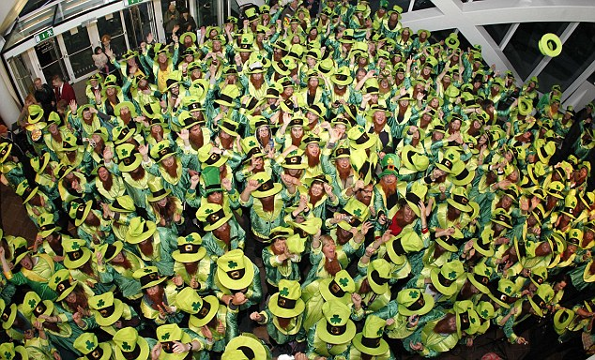
World record
A guy from Ireland got a record on November 8th 2006. his name is Liam O’Connor. He was the fastest accordion player.
The largest gathering of leprechauns in Ireland is 262 people. It happened in 2013.
Liam O’
Conor
Leprechauns.

Slide 9
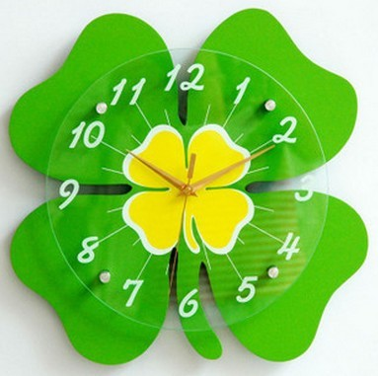
Time in Ireland compared to here.
Dublin’s 6 hours ahead of Illinois. So if it were 9:00 A.M. here then it would be 3:00 P.M. in Dublin.

Slide 10
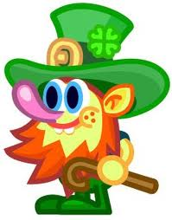
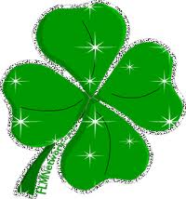
Thanks For reading!
I Love Ireland! BYE!

