Slide 1
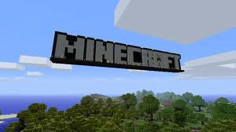
Minecraft tips
By Zack Parks

Slide 2
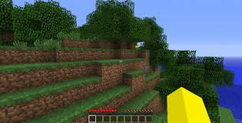
About and what Minecraft is
Minecraft is a game about survival in a world(below is what it should be like when you spawn) . At first you have no resources but you can get wood by hitting trees with your hands, that’s odd . Then you can turn wood into planks with your inventory crafting(default it is E to open inventory). To get ores, stone, and sandstone you need a pickaxe(slide 5 how to craft). Minecraft.net is where you buy and download the game. You can find out more about the game at Minecraft wiki

Slide 3
Items
wood
How to make sticks, crafting bench, and wooden planks
Wooden planks
Sticks
Crafting bench
Wooden
Planks
Wooden Planks
Wooden planks
Wooden planks
Wooden planks
Wooden planks

Slide 4
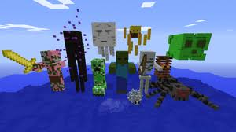
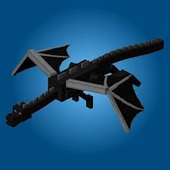
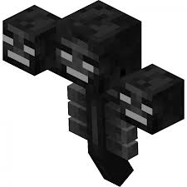
Hostile mobs
Over world
Creepers, Enderman(if provoked) ,
Slimes, silverfish, and spiders
Skeletons, Spiderjockeys, Zombies and rarely
Zombiepigmen
Nether
Blaze
Ghast
ZombiePigmen (if provoked)
Wither skeleton
Bosses : Ender Dragon, and Wither

Slide 5
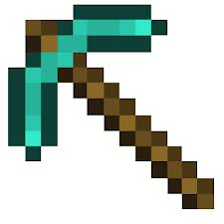
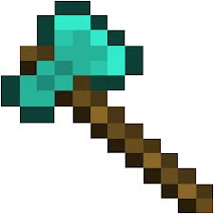
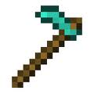
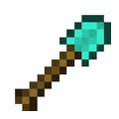
Tools
r
Pickaxe
Axe
Hoe
Shovel
sticks
r
r
r
r
R stands for resources like diamonds wood iron stone or gold

Slide 6
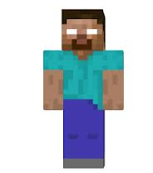
Herobrine
Is a minecraft legend/hoax of the creator Notch’s dead brother was used as first Enderman

Slide 7
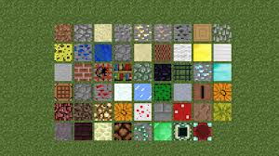
blocks
Blocks are items in minecraft that can be placed and destroyed; these are some blocks (not all blocks)
Obsidian
Wood
Wooden planks
Stone
Coal ore
Iron ore
Gold ore
Redstone ore
Diamond ore
Emerald ore
netherrack
You can only stack blocks up to 64 in your inventory

