Slide 1
Celebrity Stuff
By Blerina Mimini

Slide 2
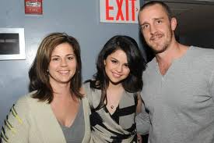
Selena Gomez
Selena and her mom and dad

Slide 3
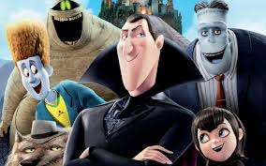
Selena Gomez
TV Shows
Movies
Wizards of Waverly Place
Barney and Friends
Hannah Montana
The Suite Life of Zack and Cody
Hotel Transylvania
Mote Carlo
Ramona and Beezus
Another Cinderella
Story

Slide 4
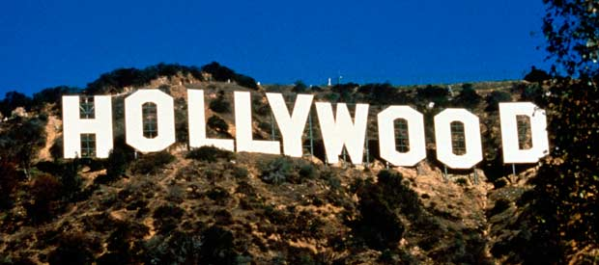
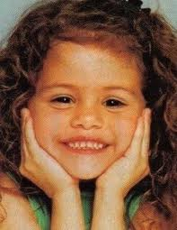
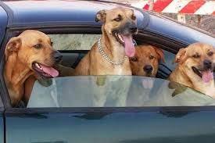
Selena Gomez
B-Day: July 22, 1992
Selena at age 6
Lives in Los Angeles
Selena’s 4 Dogs

Slide 5
Selena Gomez’s awards
Won Favorite TV Actress in 2009-2012
Won Favorite female singer in 2012
This year she was nominated for favorite TV show and for favorite TV actress!

Slide 6
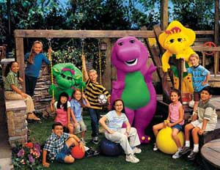
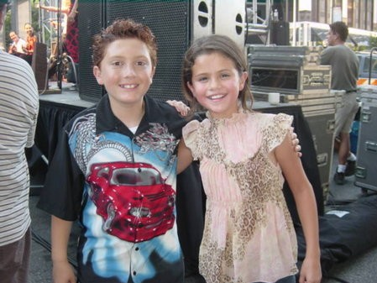
Selena in Barney and friends
Selena’s first TV show Barney and Friends!
Selena’s first movie was Spy Kids 3-D game over!

Slide 7
Selena Gomez
Born: July 22,1992
Age: 20 (2013)
Home Town : Texas

Slide 8
Selena Gomez
Selena’s first song was “headfirst”
Selena’s last song she wrote is “love you like a love song”

Slide 9
Selena Gomez
Selena and her best friend Demi Lovato

