Slide 1
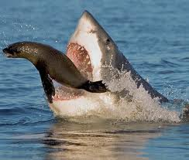
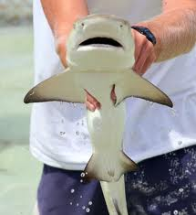
sharks
justice

Slide 2
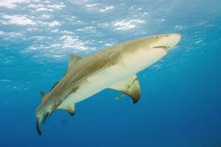
Lemon sharks
They can get up to 7.9 to ten feet. They have a flattened head with a short broad snout, and the second dorsal fin is almost as big as the first.

Slide 3
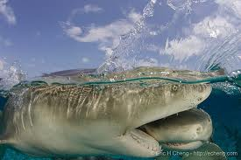
Lemon sharks
They are called lemon sharks because light interacting at certain depths with the salt water can give this shark a tanned and yellow pitted appearance.

Slide 4
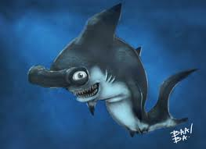
Hammer head sharks
Hammer head sharks use their wide eyes to give them a better range then a lot of other sharks, by spreading their special organs on their head they can find food easier.

Slide 5
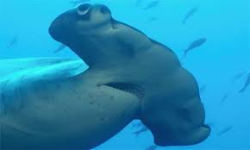
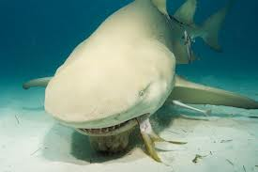
Hammer head sharks live in the Pacific, Indian and the Atlantic ocean.
The Lemon sharks live in the Caribbean

Slide 6
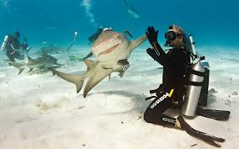
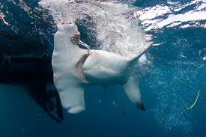
Lemon shark Hammerhead shark

Slide 7
THAT’S ALL

