Slide 1
sinkholes
by: Alivia Curtis Zack

Slide 2
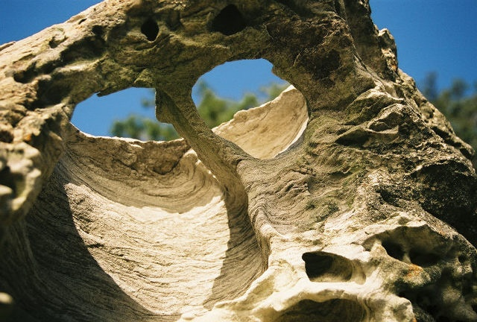
Weathering and erosion
WEATHERING
THE DECOMPOTION OF ROCKS,SOIL AND MINERALS.
EROSION
WHEN SOMETHING GETS PUSHED TO ANOTHER AREA.

Slide 3
Natural resources
Renewable
nonrenewable
Wood cucumbers
Oil iron

Slide 4
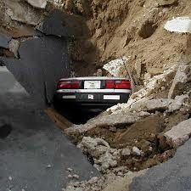
Sinkholes
Sinkholes can cause a lot of destruction. Sinkholes are most common in watery areas like Florida.
There so dangerous they can swallow whole cars!!!

Slide 5
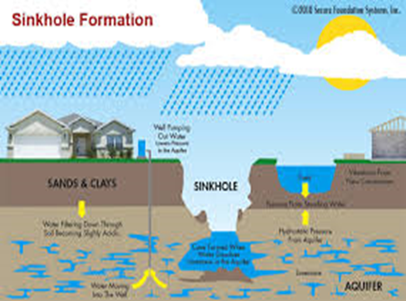
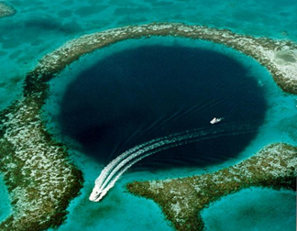
Can it be prevented?
No sinkholes can not be prevented.

Slide 6
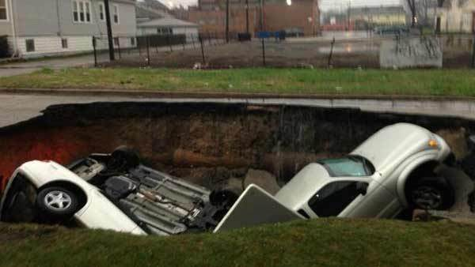
How it got its name
It got its name because it is a hole that sinks in the ground.
IT CAN SWALLOW THREE OR MAYBE MORE CARS.

Slide 7
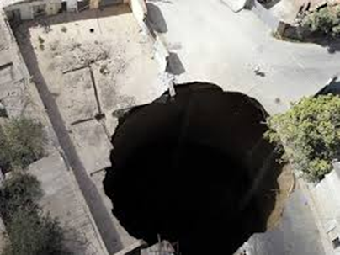
How we react
If you see a sinkhole forming calmly get out of the area.

Slide 8
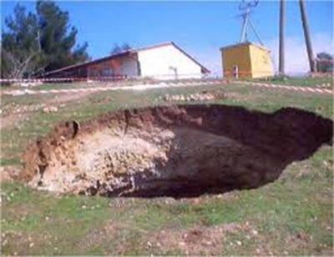
It Can be predicted
Scientists have come up with technology to read cave so you can find sinkhole caverns before they collapse.

Slide 9
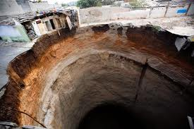
Pictures of sinkholes

Slide 10
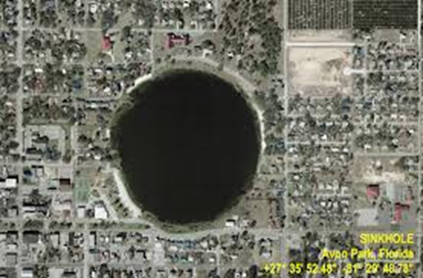
facts
Sinkholes can be up to 600 meters deep
If this ever happens don’t worry if it damages your house or apartment neighbors are most likely to help you out.
They can also collapse a house into itself

Slide 11
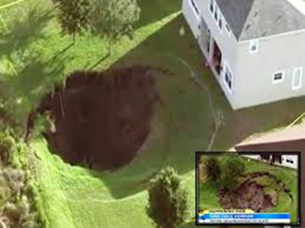
SINKHOLE FUNFACTS
THERE ARE TWO TYPES OF SINKHOLES SOLUTION AND SUBSIDENCE.
THE STATES FLORIDA, TEXAS,KENTUCKY,ALABAMA,
MISSOURI,TENNESSEE, AND PENSILVANIA

Slide 12
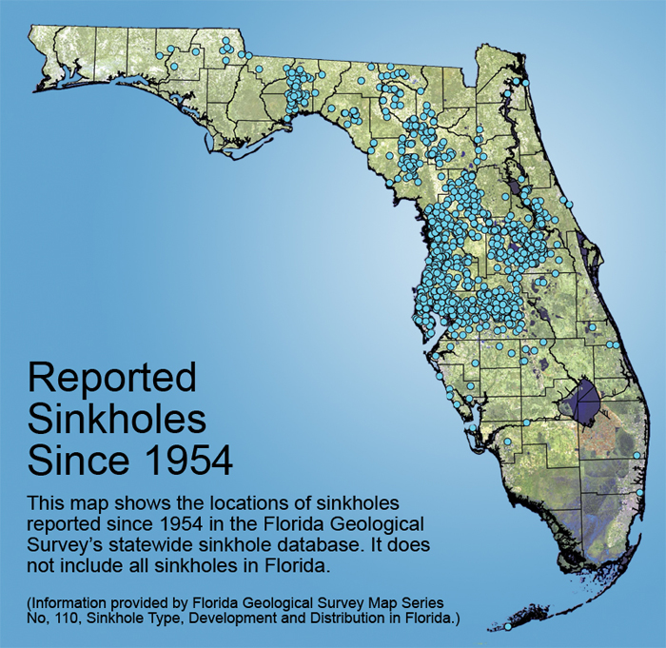
Florida sinkhole map

Slide 13
Pictures of sinkholes

Slide 14
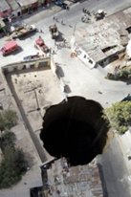
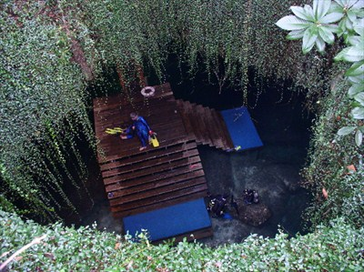
Pictures of sinkholes

Slide 15
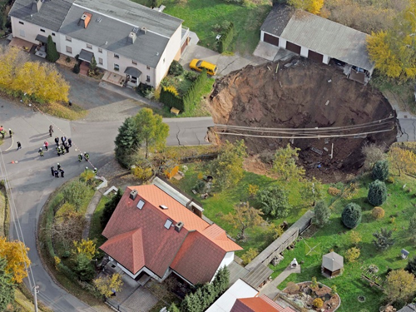
Safety
Sinkholes can be very dangerous they can suck people in there.
Its so deadly that it can suck up your house. P.s. its safer to be inside your home then outside.

Slide 16
Ending
Thanks for reading hope it help your family!!

