Slide 1
superstar action!
By: Garrett sage

Slide 2
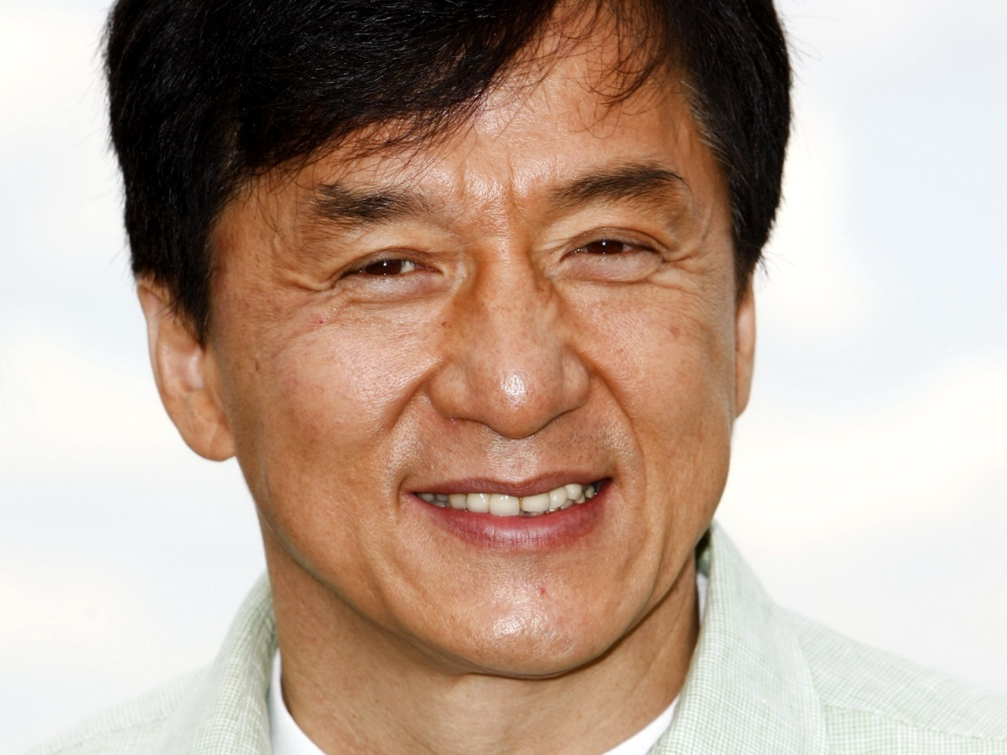
Do you know a famous actor who is awesome and has been around for quite a long time ? Do you? Well I do, Jackie Chan. He was born April 7, 1954 at Victoria Peak. He has four siblings. They are Fang Shiseng, Fang Shide, Yulan Chan and Guilan Chan. His parents are Lily Chan and Charles Chan. He is a young 58 years old right now and his wife is Lin Feng-Jiao. His children are Jaycee Chan and Etta Ng Chok Lam.

Slide 3
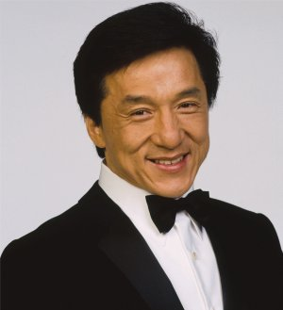
Jackie Chan was the voice of Monkey in Kung Fu Panda. It was aired June 6, 2008 and was rated PG. The directors were John Wayne Stevenson and Mark Osborne. One of his other movies was The Karate Kid and it is one of my favorites. The release date was June 11, 2010 and is also rated PG. The director was Harold Zwart. Jackie is now the official holder for the Guinness World Record for the most credits in one movie AND the most stunts by a living actor. You go Jackie Chan!

Slide 4
Other movies he was in
The Spy Next Door rated: PG
Kung Fu Panda 2 rated: PG
Around The World In 80 Days rated: PG
The Cannonball Run rated: PG
Rush Hour 3 rated: PG-13
The Forbidden Kingdom rated: PG-13
Shanghai Noon rated: PG-13
Who Am I? rated: PG-13
Rush Hour rated: PG-13
Project A rated: PG-13

Slide 5
Jackie Chan’s Favorite’s
Favorite Color: Blue
Favorite Place Sushi Shops
Favorite Food: Sushi
Favorite Animal: North American Black Bear
Favorite Movie: An Inconvenient Truth

Slide 6
Did you know Jackie Chan make’s 4,563,546 dollars a year! Do you know how much he would get in 5 years?
(22,817,730)

Slide 7
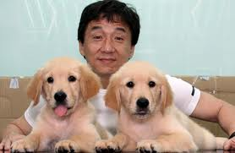
one more Picture of Jackie Chan
And that’s all for Superstar Action I’ll see you next time!
You have to love those pups!

