Slide 1
Tornado
Nick Libby Dakota

Slide 2
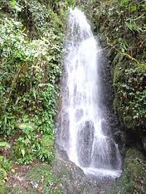
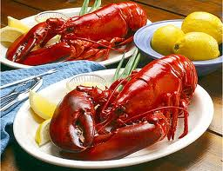
Natural resources
\
Water is a natural resource and the animals that live in it like Lobster

Slide 3
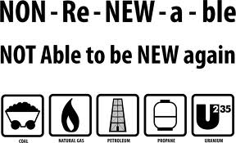
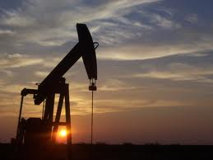
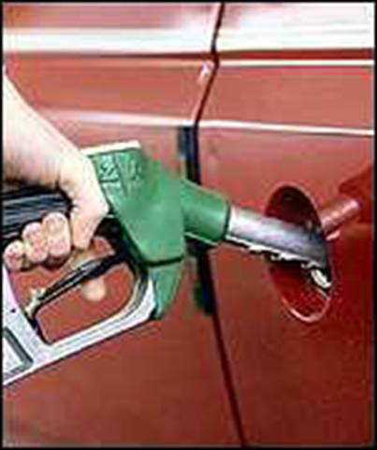
Nonrenewable
Oil it is Nonrenewable because When It runs out there’s no More.
Nonrenewable
Gas is Nonrenewable Because it is made from Oil.

Slide 4
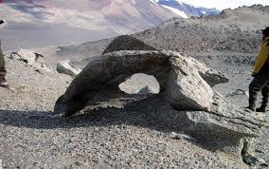
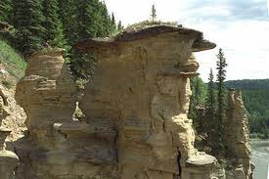
Weathering & Erosion
Weathering
Erosion
Weathering
This is a Rock Formation Made by Weathering
Erosion
This is a River formed by Erosion

Slide 5
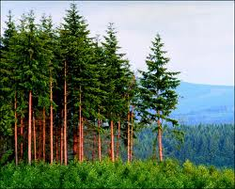
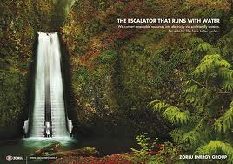
Renewable Resources
Renewable
Renewable
Trees
Trees are Renewable Because they come back over Time
Water
Water is Renewable Because Rain Water makes it Come Back

Slide 6
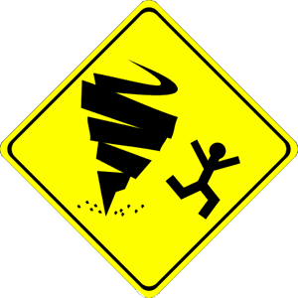
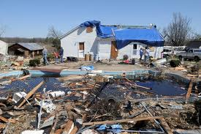
Tornado Damage
Tornado Damage
This is What a tornado can do.
Tornadoes are dangerous.

Slide 7
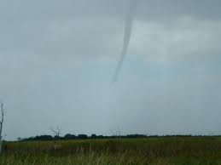
How Tornadoes Form
It starts in a change in Wind Direction Speed increases the Height and Heat.

Slide 8
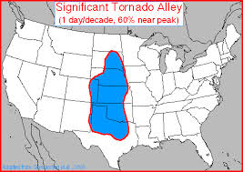
Where Tornadoes Form The Most
Where Tornadoes Form The Most
Tornadoes form the most in Tornado Alley.

Slide 9
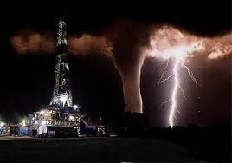
How do Tornadoes Get their names
The Spanish word for tornado is tronada Which means thunderstorm.

Slide 10
Tornado Video
This is a fire tornado Video
http://www.youtube.com/watch?feature=player_detailpage&v=5SyX2NUEkKk

Slide 11
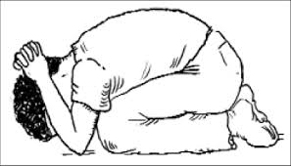
How to react from tornadoes at School
Go into the Bathrooms or Locker Rooms

Slide 12
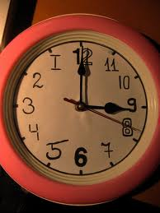
When Tornadoes Often Happen
Tornadoes Often Happen in the Afternoon.
Tornadoes happen at this time most.

Slide 13
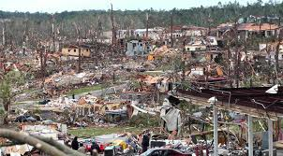
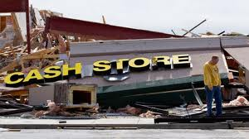
Comparing Destruction
Tornado Destruction
Twister Destruction
This is How much Destruction a Tornado does.
This is How much Destruction a Twister does.

Slide 14
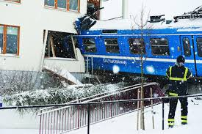
This is what can happen from Tornadoes

Slide 15
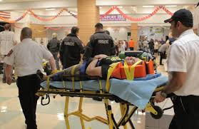
How many have Suffered from Tornadoes
24 Have suffered

Slide 16
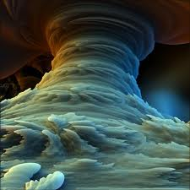
This is the End of our Slideshow.
Thanks for watching!

Slide 17
Prevented and predicted
prevented
predicted
You can go in to a locker room you can not stop tornados from happening.
Can you predict how long a tornado last?

