Slide 1
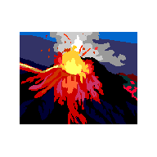
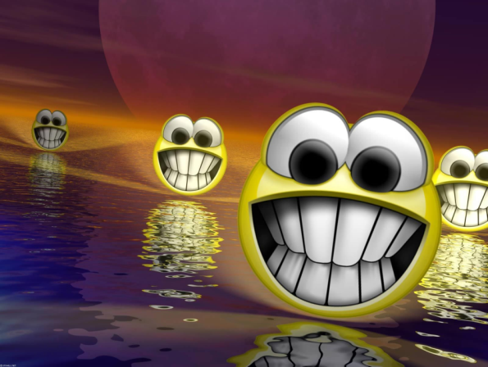
Volcano Presentation
Learn about volcanoes!! ☺ By: Morgan , Garrett, and Erin

Slide 2
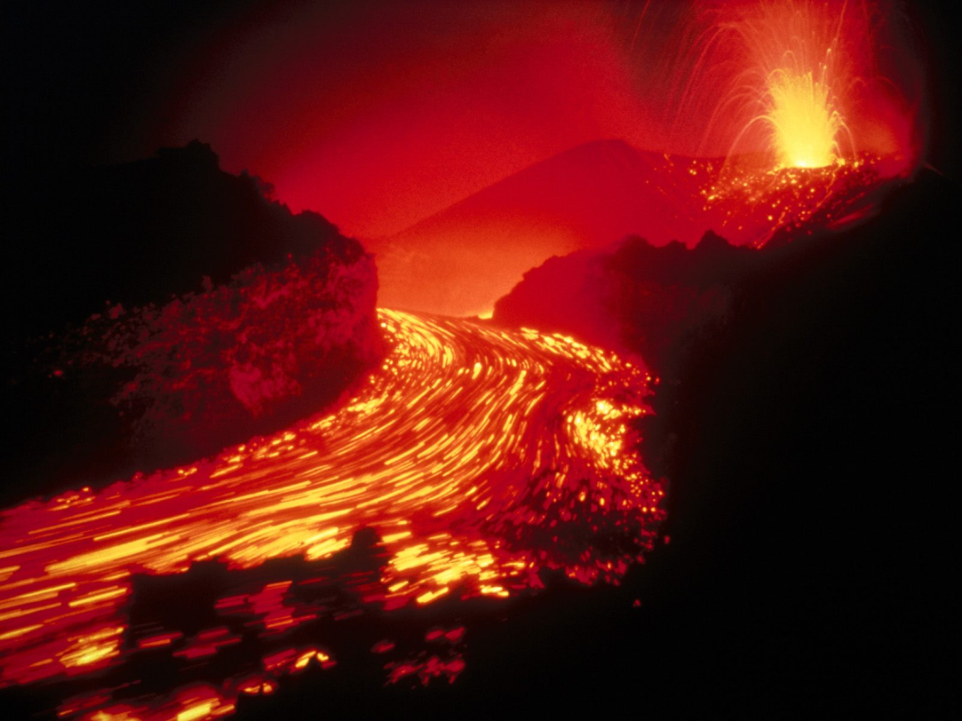
Volcanoes
Volcanoes occur when earths plates pull apart using magma to rise to the surface.

Slide 3
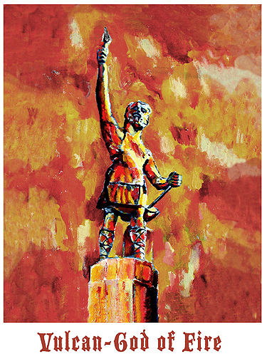
Vulcan the god of fire
Volcanoes got its name from the roman god of fire (vulcan).

Slide 4
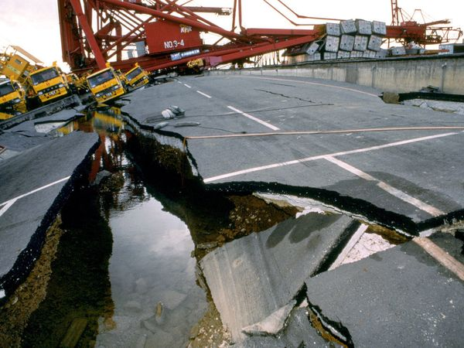
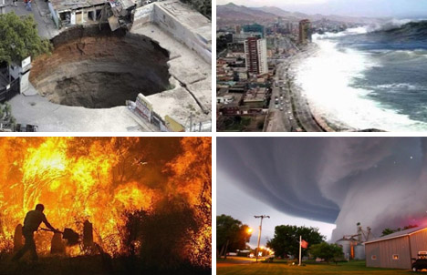
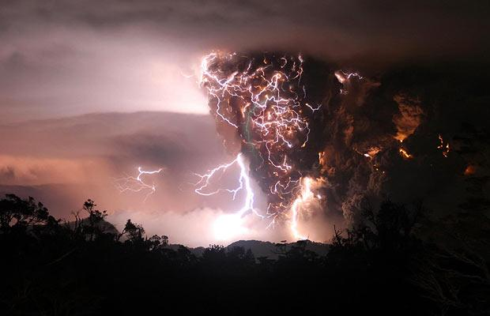
Volcanoes are dangerous
Volcanoes are usually less dangerous then other natural disasters.

Slide 5
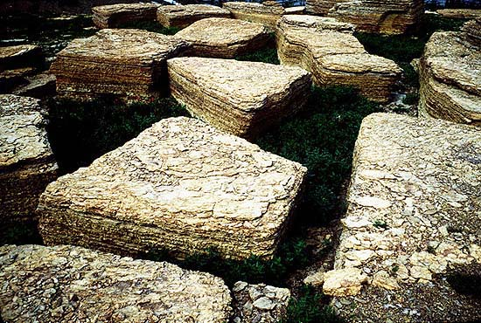
What is weathering?
Weathering is the breaking down of rocks soil and minerals.

Slide 6
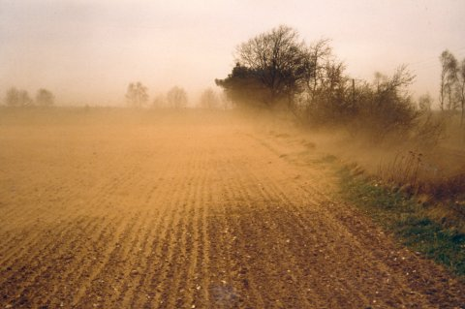
What is erosion?
Erosion is when materials are removed from the surface and changed into something else.

Slide 7
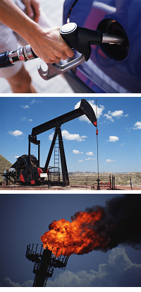
What is a non renewable resource?
It is something that can run out. For example: gas and oil.

Slide 8
What is a renewable resource?
It is something that you can use over and over. For example: juice and tuna.

Slide 9
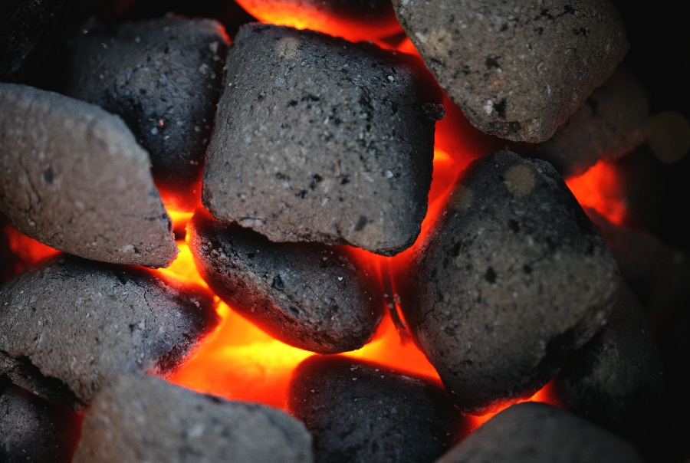
What is a natural resource?
A natural resource is coal.

Slide 10
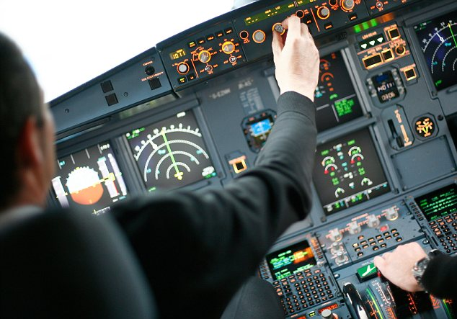
Can it be prevented?
Currently it is impossible to prevent a volcanic eruption.
But it is possible to prevent it like pouring cold water on it

Slide 11
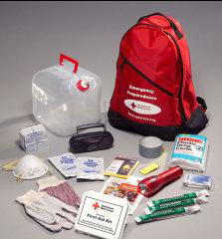
What to do
If you live in a volcanic hazard area, plan a route and have a backup route.

Slide 12
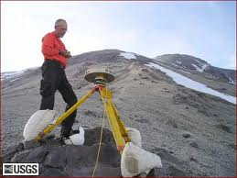
Can it be predicted?
Scientists are trying to predict volcanic eruptions.
If they predict it wrongly they wont be able to evacuate all citizens near the volcano.

Slide 13
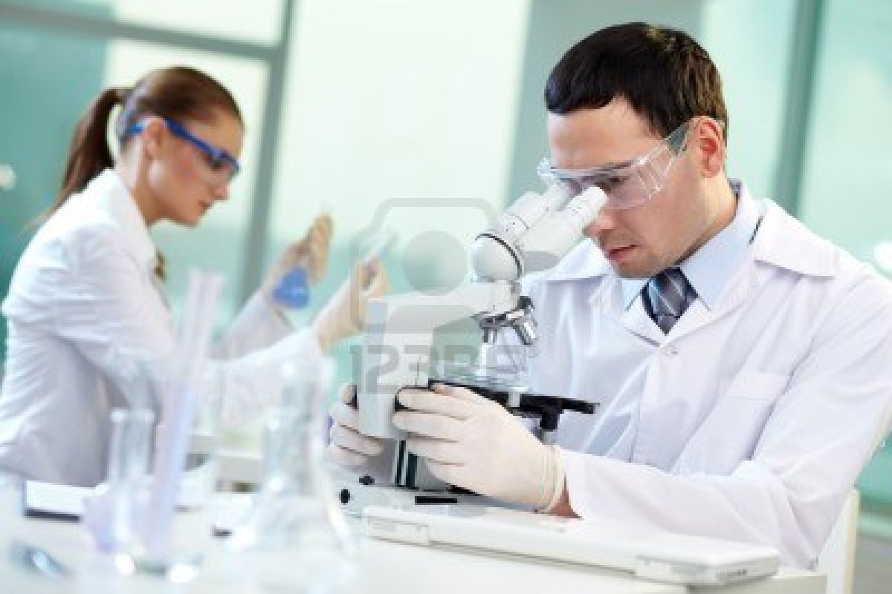
Scientists work really hard to predict volcanoes.
They keep you safe from natural disasters.

Slide 14
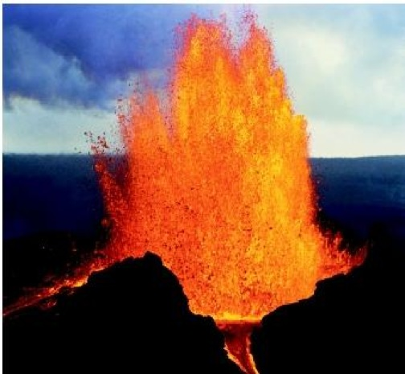
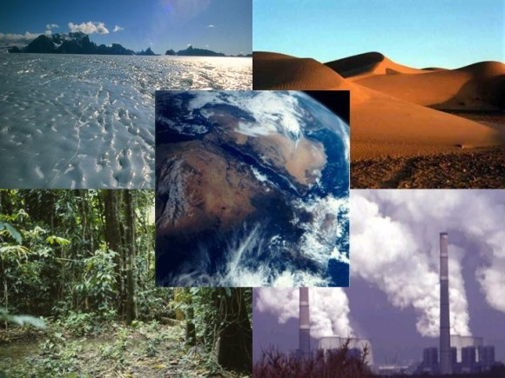
Look out for natural disasters.☺

Slide 15
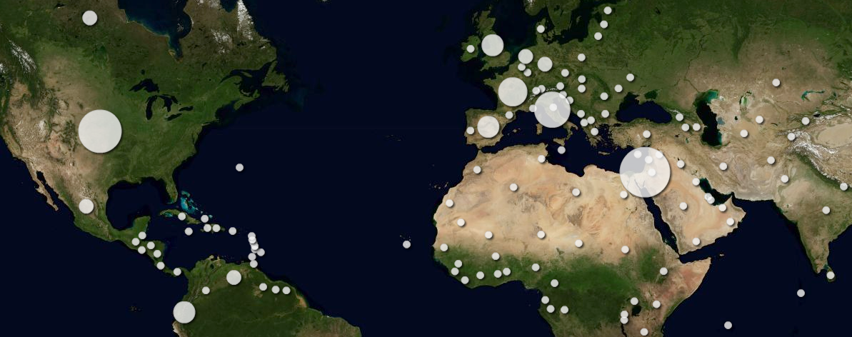
This is a map of where most volcanoes erupt.

Slide 16
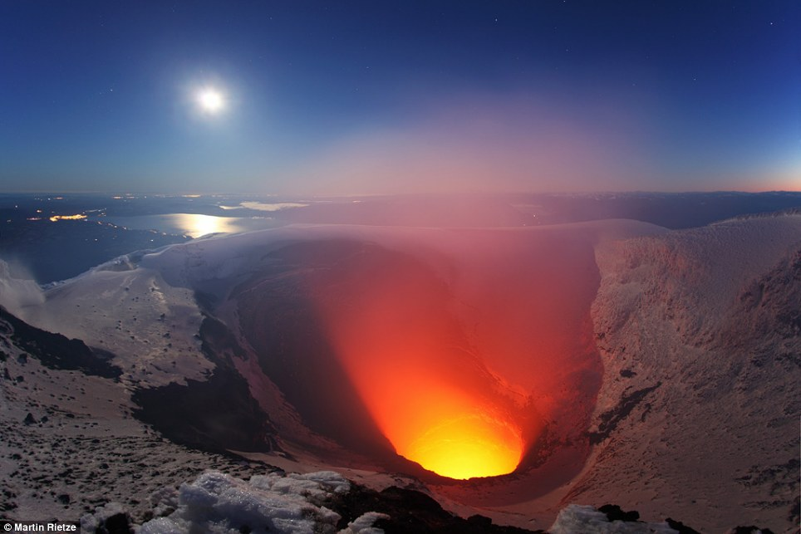
How volcanoes occur.
volcanoes occur when earths plates pull apart causing magma to rise to the surface.

Slide 17
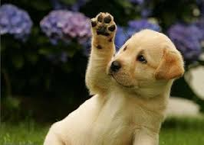
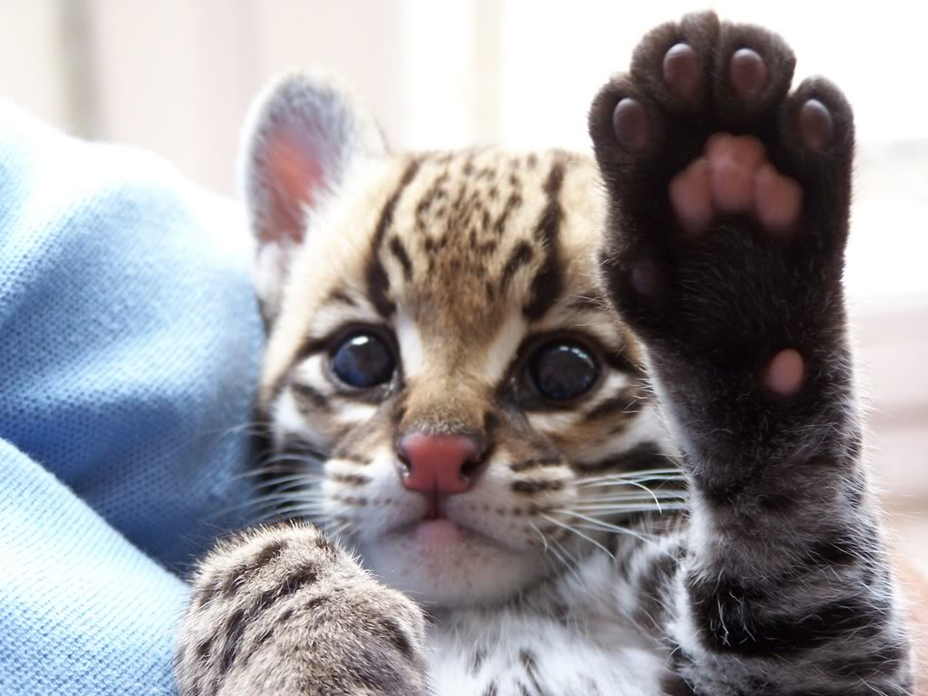
Hope you had fun learning about volcanoes. Bye ! ☺☺☺☺

