Slide 1
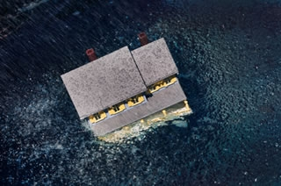
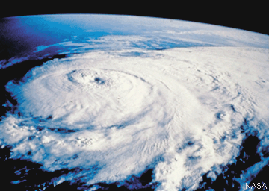
Hurricanes
By: Josh, Francisco, and Carissa

Slide 2
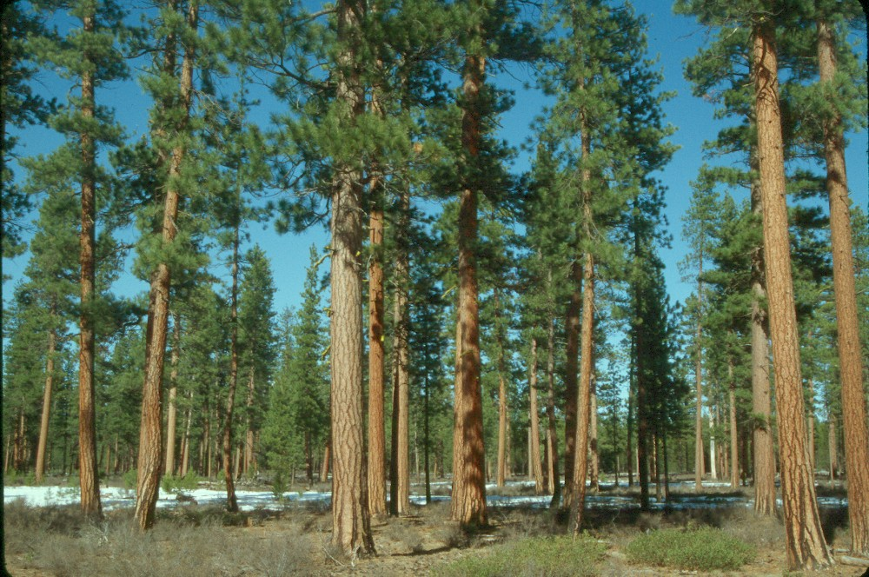
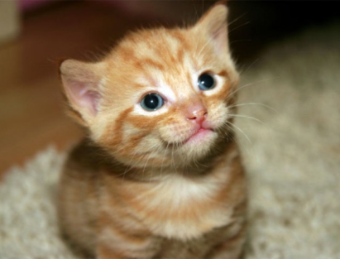
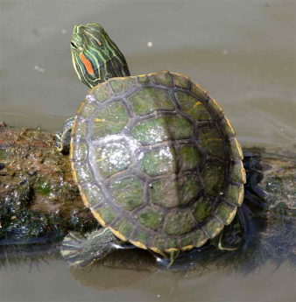
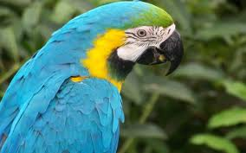
Natural Resources
Natural resources are something people can use and are made using nature.
A renewable resource is a resource that can be replenished with the passage of time. Some examples are animals and water.

Slide 3
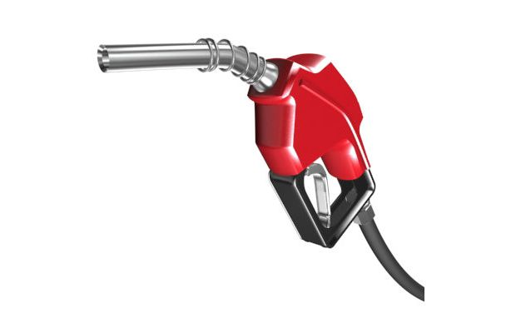
Nonrenewable Resources
A NONRENEWABLE
RESOURCE IS SOMETHING THAT CAN’T BE USED OVER AND OVER. SOME EXAMPLES ARE OIL AND GAS.

Slide 4
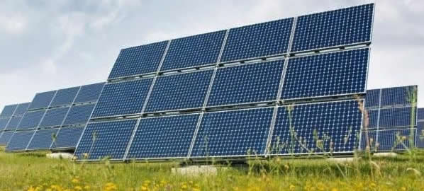
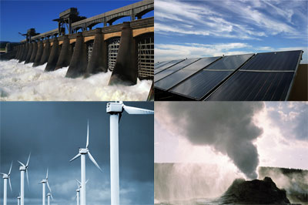
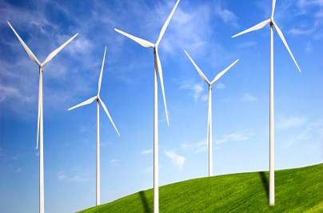
Renewable resources
A renewable resource is something that would never run out and it would just keep coming and coming. Some examples are a solar panel, or windmills.

Slide 5
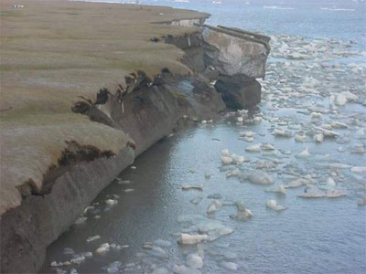
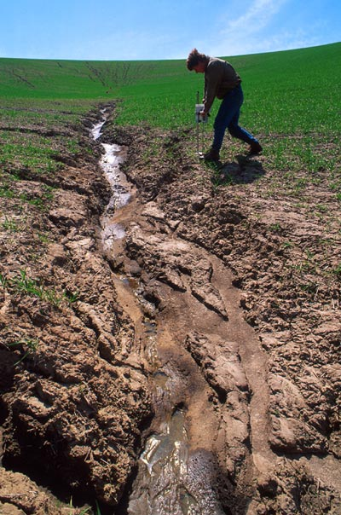
Erosion
Erosion is the process of eroding or being eroded by wind, water or other natural agents
Example it carries things like water ,ice and other things.

Slide 6
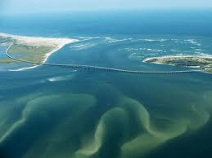
WEATHERING
WEATHERING CAUSES THE DECINTEGRATION OF ROCK
NEAR THE SURFACE OF
THE EARTH.

Slide 7
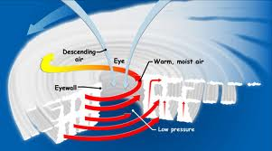
WHAT CAUSES IT
YOU NEED WARM WATER AND MOIST WARM AIR. THAT’S WHY HURRICANES ONLY HAPPEN IN THE TROPICS.
ATLANTIC HURRICANES TAKE SHAPE WHEN STORMS ALONG THE WEST COAST OF AFRICA DRIFT OUT OVER WARM OCEAN WATERS WHERE THEY ARE AT LEAST 8O DEGREES FARRENHEIT WHERE THEY ALSO ENCOUNTER CONVERGING WINDS FROM AROUND THE EQUATOR.

Slide 8
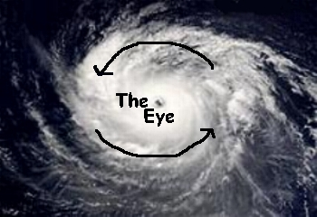
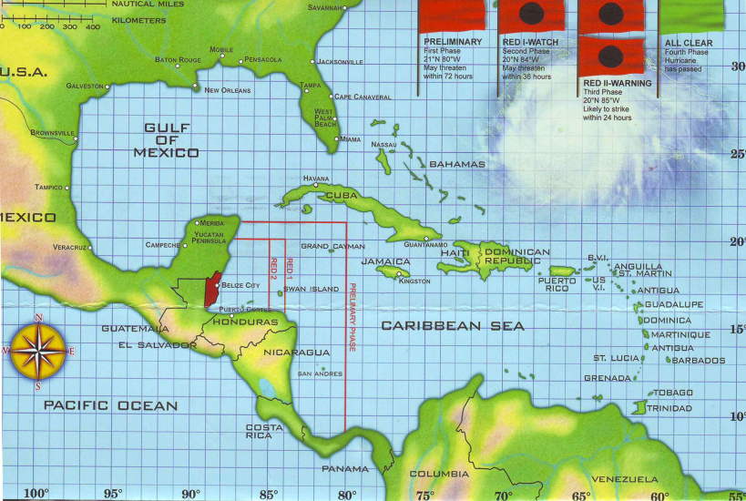
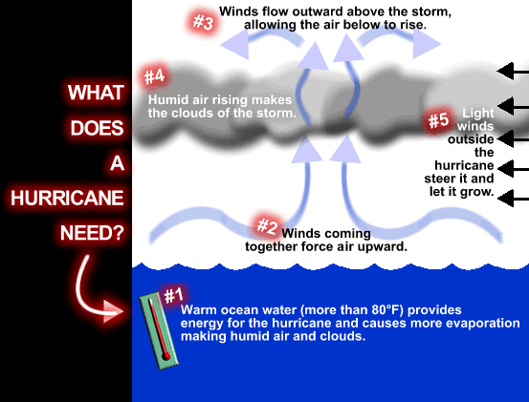
Where Do Hurricanes form the most?
They form most in the Caribbean, or the Gulf of Mexico, where the water is very warm. In the East pacific, they tend to form off the West coast of Mexico.

Slide 9
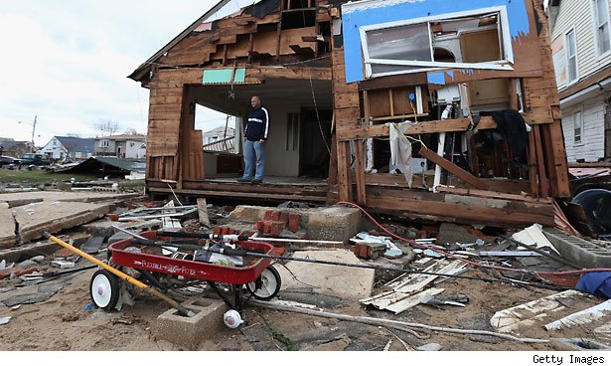
How dangerous can hurricanes be?
Hurricanes can damage trees, shrubs, houses, trailer homes, docks, and small boats. Hurricanes kill many people. Luckily, they never happen where we live! They can pretty much damage anything!

Slide 10
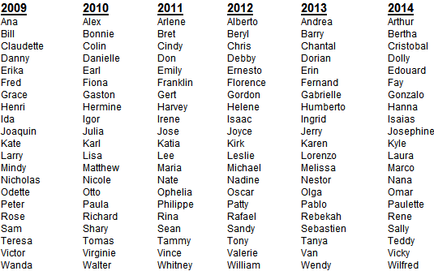
How Did Hurricanes Get Its Name?
Names Of Hurricanes
There are many more hurricane names. Hundreds probably.
Isaac
Kirk
Sandy
Henri
Ana
Bill
Claudette
Danny
Erika
Fred
Grace
Ida
Kate
Larry
Mindy
Nicholas
Sam
Rose
Victor
Wanda
Alex
Lisa
Thomas
Richard
Nicole
Matthew
Juli
Shary
Walter
Joyce
Jerry
Bonnie
Bill
Andrea
Hanna

Slide 11
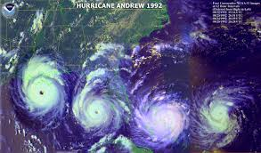
Can Hurricanes Be Prevented?
no, all I could find was that a hurricane can not be prevented.

Slide 12
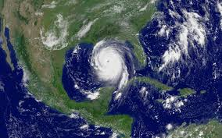
Can Hurricanes Be Predicted?
They can be predicted. Scientists use a satellite that shows them pictures of where the hurricane is forming on a map of the area. They look on a computer to see where it’s coming from and where it is heading to.

Slide 13
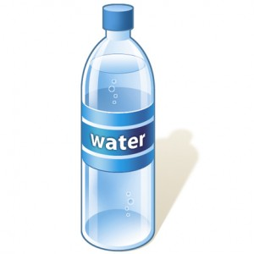
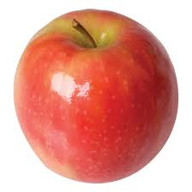
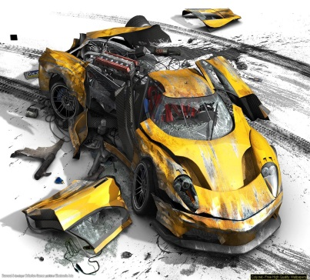
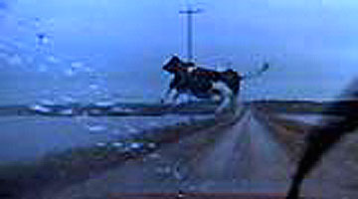
Safety From Hurricanes
Here are some tips on how to stay safe from hurricanes when they occur.
Stay away from windows or doors because wind could blow in and take you out of the window.
Make sure you have a flashlight in a safe room.
NEVER go outside because you could get hit with something and get seriously injured or die.

Slide 14
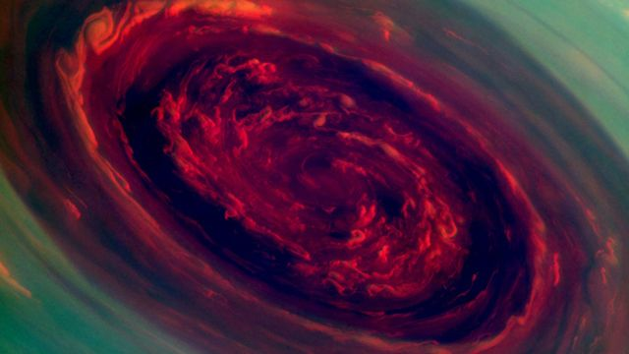
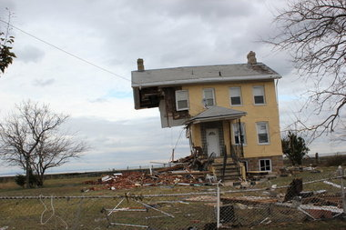
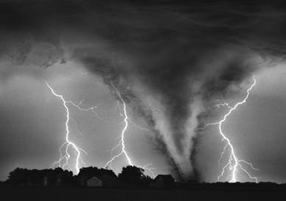
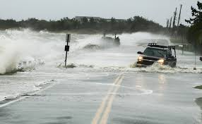
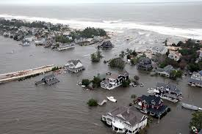
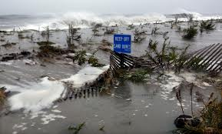
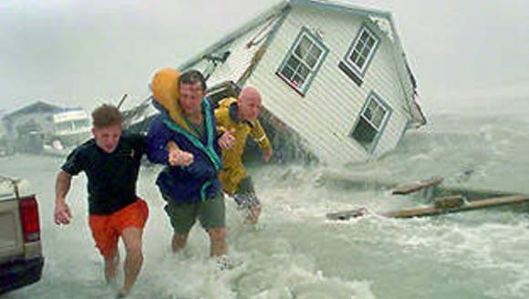
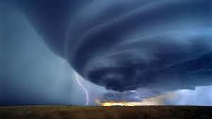
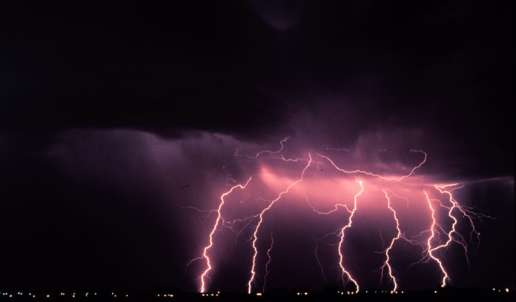
Pictures Of Hurricanes!

Slide 15
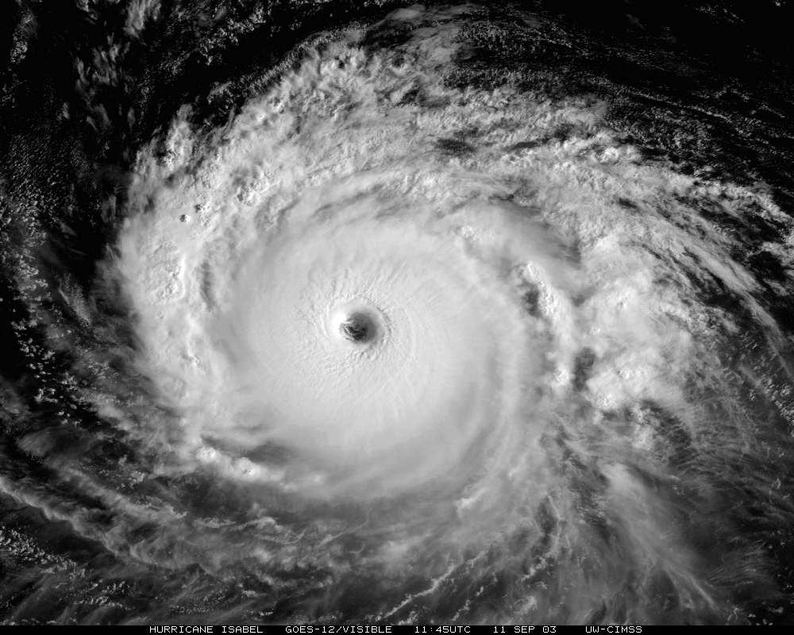
Thank You for watching this power point!
We hope you enjoyed it! ☺

