Slide 1
NATURAL RESOURCES
By Peyton,Katelyn,Blerina

Slide 2
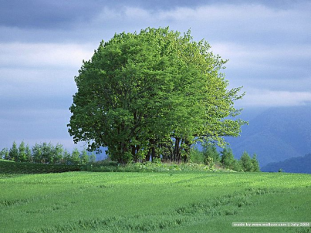
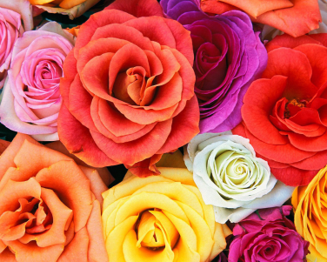
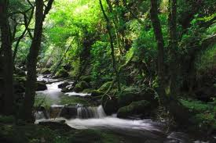
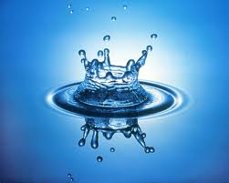
What is a natural resource?
A natural resource is …
For example…
A natural resource is an animal or a plant that comes naturally.
1.A tree
2.A flower
3.Water

Slide 3
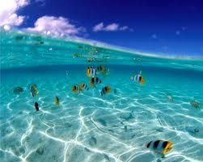
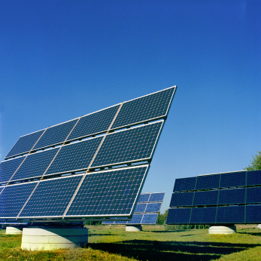
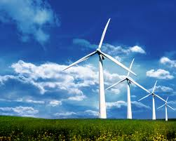
What is a renewable resource?
Here are some renewable resources.
A renewable resource may be the source of power for renewable energy.

Slide 4
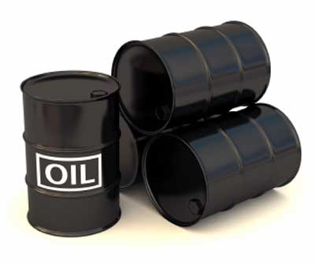
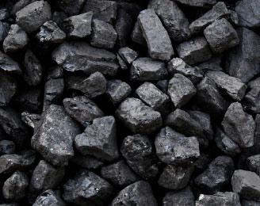
What is a nonrenewable resource?
A nonrenewable resource is made up of deceased organic material.

Slide 5
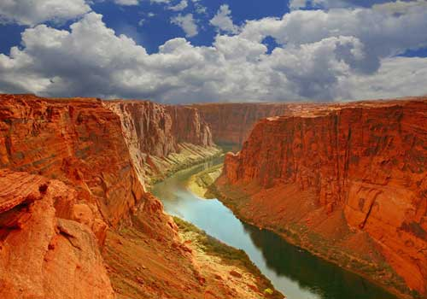
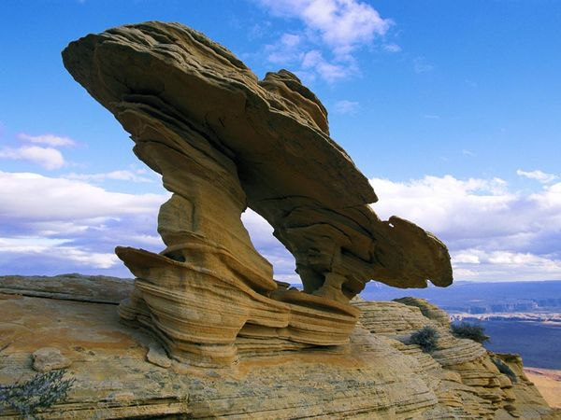
What is erosion?
Erosion is made when the earth gets worn down . It can be caused by the earth’s reaction like a big shake.
The grand canyon is an erosion caused by the earth.

Slide 6
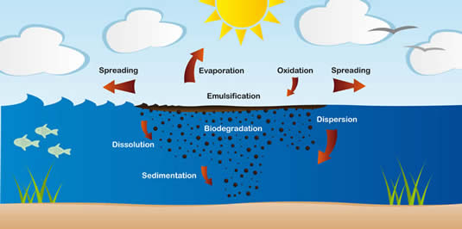
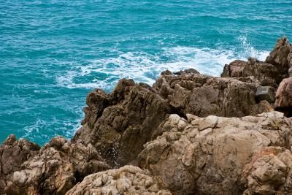
What is weathering?
Weathering is the breaking down such as rocks and minerals.

Slide 7
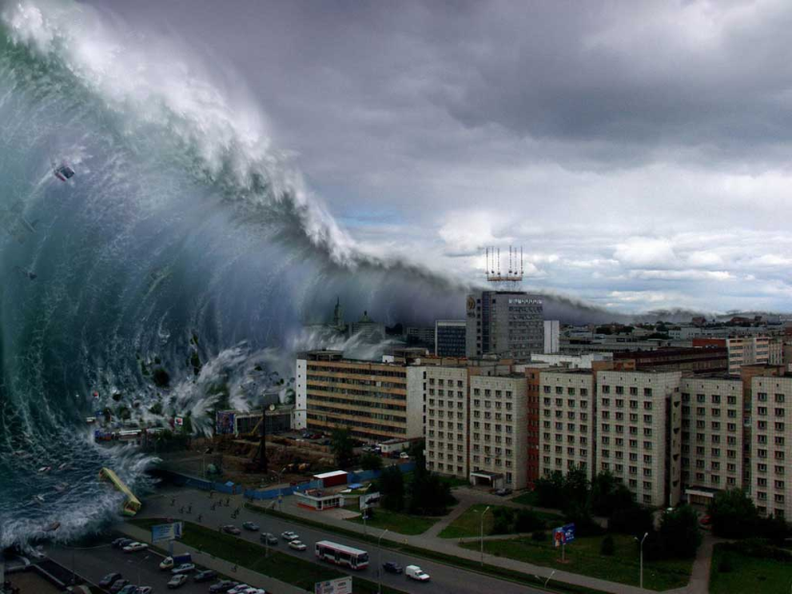
Natural Disaster (Tsunami)

Slide 8
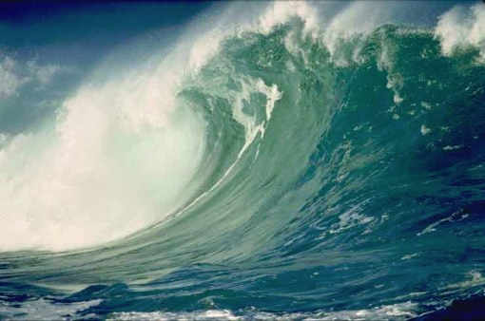
How does a tsunami occur ? What causes it ?
An earthquake starts a tsunami.
A tsunami is a BIG wave.

Slide 9
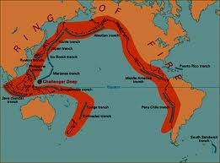
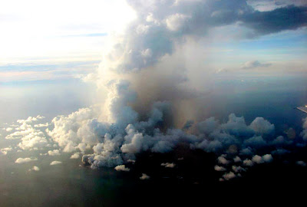
Where does a tsunami form the most?
The ring of fire is a under water volcano.
A under water volcano.
The ring of fire.

Slide 10
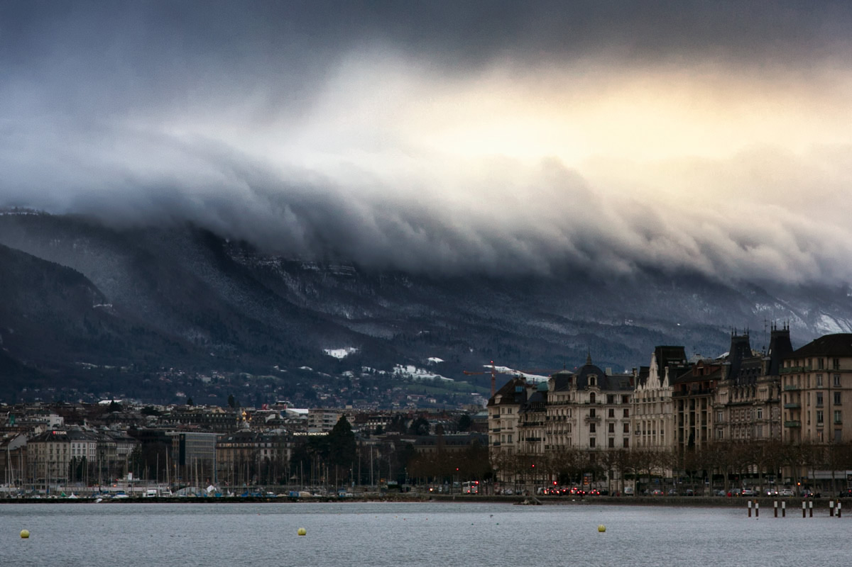
How dangerous is a tsunami ?
A tsunami is the most deadliest natural disaster in the world because it is a very big wave that comes offshore.

Slide 11
How did tsunami’s get their names?
“Tsunami” is a Japanese word.
“Tsu” means harbor and “nami” means wave.

Slide 12
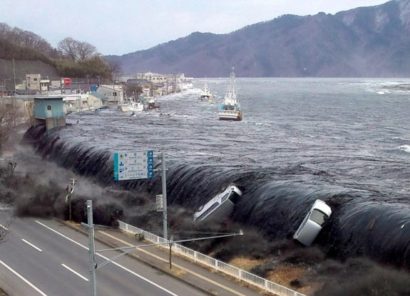
Can the tsunami be prevented?
It is very difficult to prevent.
Never go to a shoreline to see a tsunami up close.

Slide 13
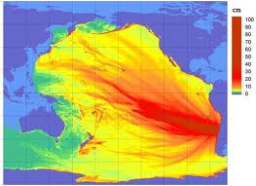
How can tsunamis be predicted?
A tsunami on a graph.
If an earthquake is carefully monitored, the tsunami's wave size and arrival time.

Slide 14
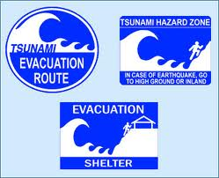
Safety how to react.
Stay away as much a possible always have an emergency kit and have a radio and help your neighbors out.

Slide 15
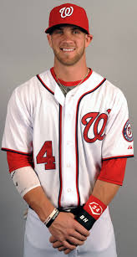
Thanks for watching have a nice day!!!!!!!!!!!!!!!!!!

