Slide 1
World records!
By: Carissa Hoffman!
Guess how many records were broken? 420,000! That’s a whole bunch of records!

Slide 2
Different Records!
The world’s longest candy cane is 51 feet long!
The longest fingernails are 19 feet long on both hands!
The most Twinkies eaten in one minute are 14 Twinkies!
Michelle Obama broke the record for the most kids doing jumping jacks!
The shortest woman is 2 feet tall and lives in India!

Slide 3
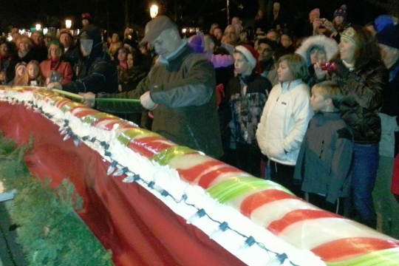
My Favorite World RecordS!
My favorite world record is the longest candy cane. I like it because I love candy! The chef’s name is Alain Roby. There was a festival in Geneva, Illinois to see and eat the candy cane! My best friend got to go there and meet the chef. The candy cane was 51 feet long! The picture below is of the candy cane being measured at the festival.
My other favorite world record is the largest Hello Kitty collection. I like it because I like Hello Kitty. Asako Kanda from Japan has 4,519 different Hello Kitty items! She even has a Hello Kitty toilet seat! The picture below is of her in her bedroom.

Slide 4
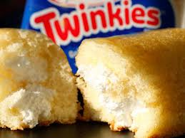
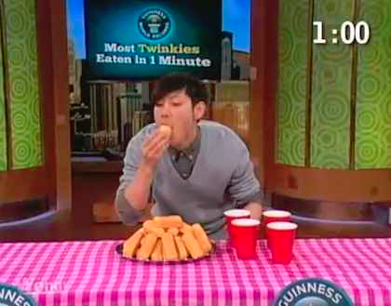
The Most twinkies eaten in one minute
In the photo next to this, Takeru Kobayashi from Japan is seeing how many Twinkies he can eat in one minute! He ended up eating 14 Twinkies! That’s a lot for one minute! Takeru was on the Wendy Williams show when he broke the record.

Slide 5
Steps to break a world record
Think of something you are good at.
Check to see what the record on that currently is.
Think to yourself, “Can I beat this?”
Train for it just incase.
When you are ready to set it, send your idea in on the Guinness world record website.
Soon, a package of instructions will come.
Make sure you’re ready for the big day.
When the day comes, try as hard as possible.
If you break the record, do a victory dance!

Slide 6
The Longest Nails!
The longest nails have been grown by Chris Walton. It must take her a long time to get a manicure! Look at those nails in the top right!
The longest nails are 19 feet long.
It took her 18 years to get her nails long.
Her nails were measured on February 21, 2011.
The nails on her left hand are 10 feet long.
The nails on her right hand are 9 feet long.

Slide 7
I hope you liked my world record research! Bye!
For more world records, buy the world record book or check them out at the library! You will find tons of facts!!!! The picture below is of the newest book, made in 2013!

